Slide 1
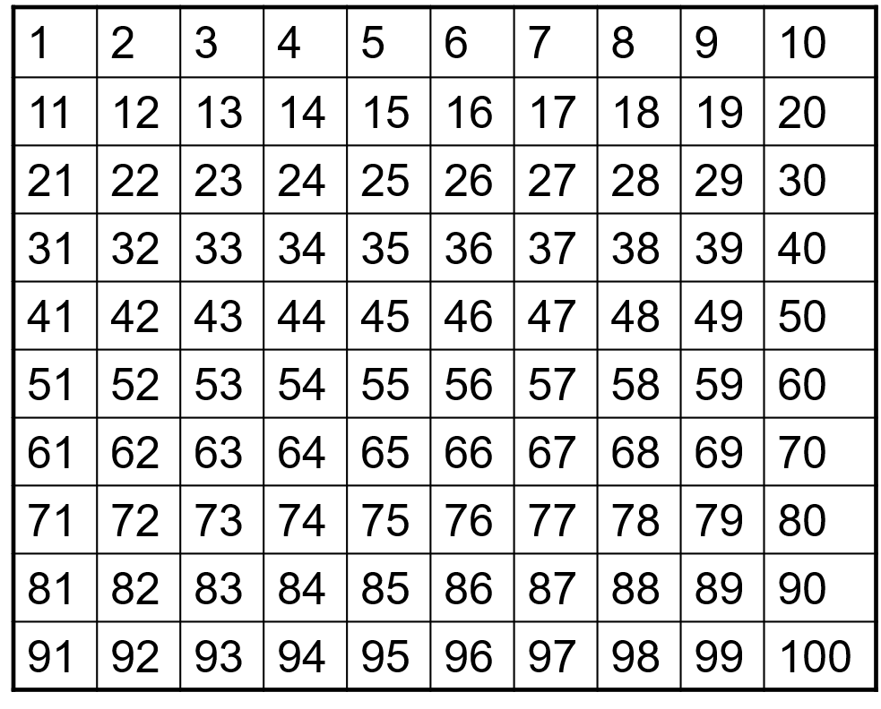
Sieve of Eratosthenes

Slide 2
Sieve of Eratosthenes
Take out the number 1 because it is
neither prime nor composite

Slide 3
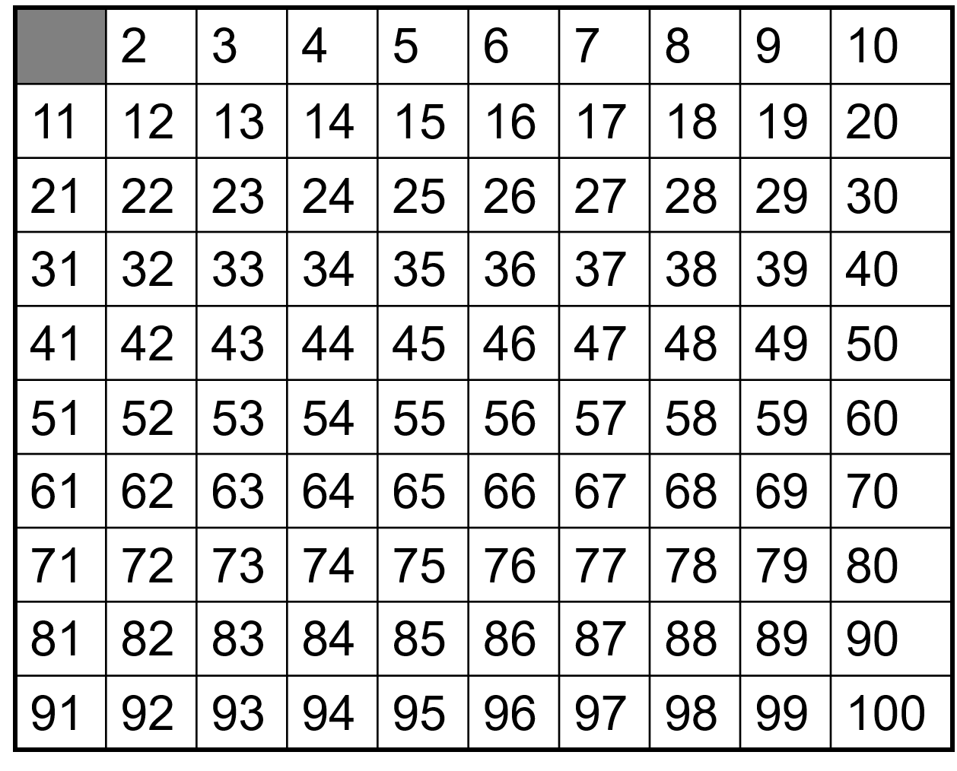
Sieve of Eratosthenes
Take out the number 1 because it is
neither prime nor composite

Slide 4
Sieve of Eratosthenes
Take out numbers that are divisible by 2

Slide 5
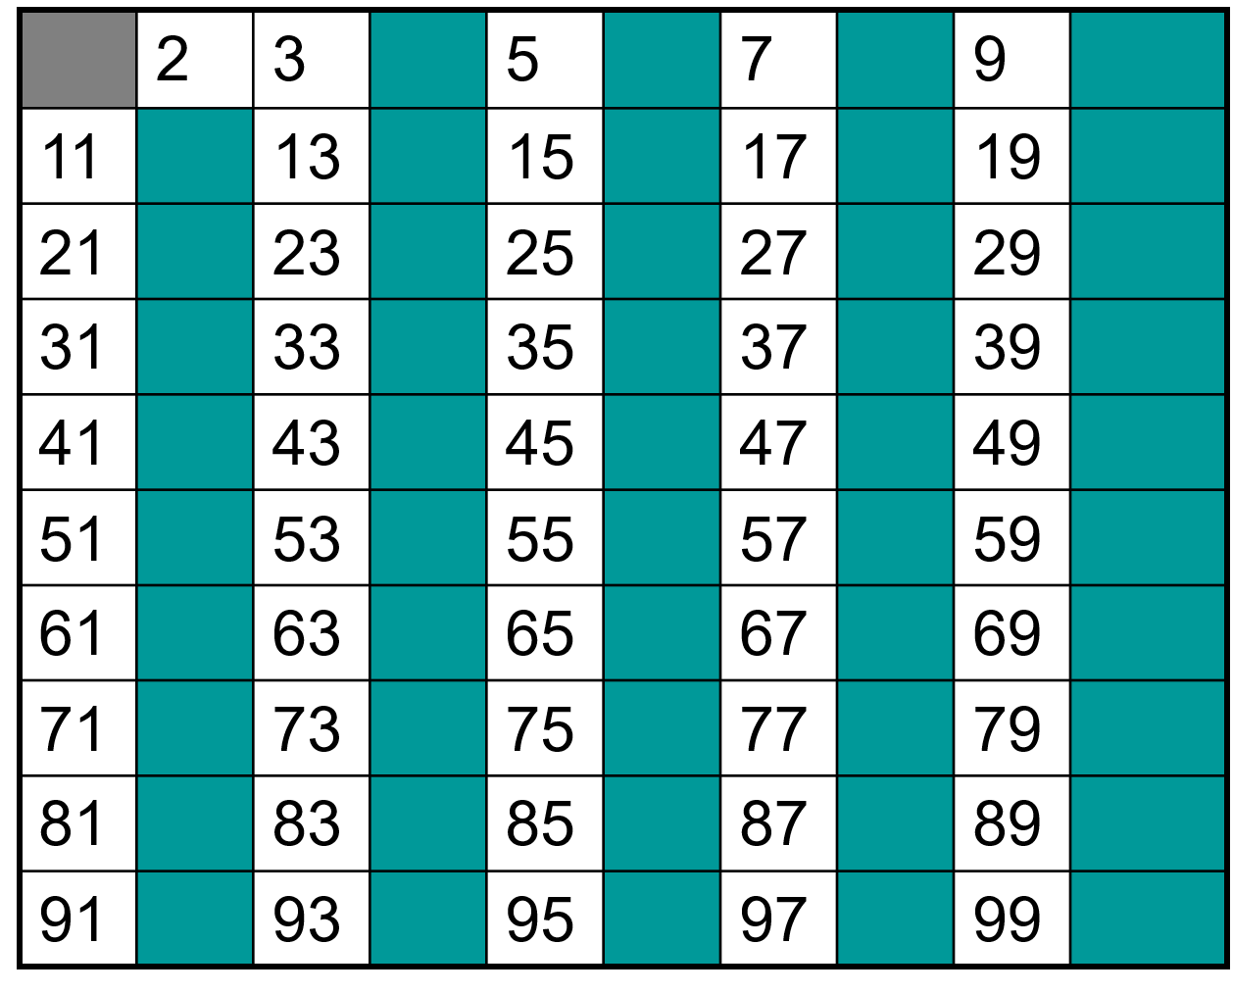
Sieve of Eratosthenes
Take out numbers that are divisible by 2

Slide 6
Sieve of Eratosthenes
Take out numbers that are divisible by 3

Slide 7
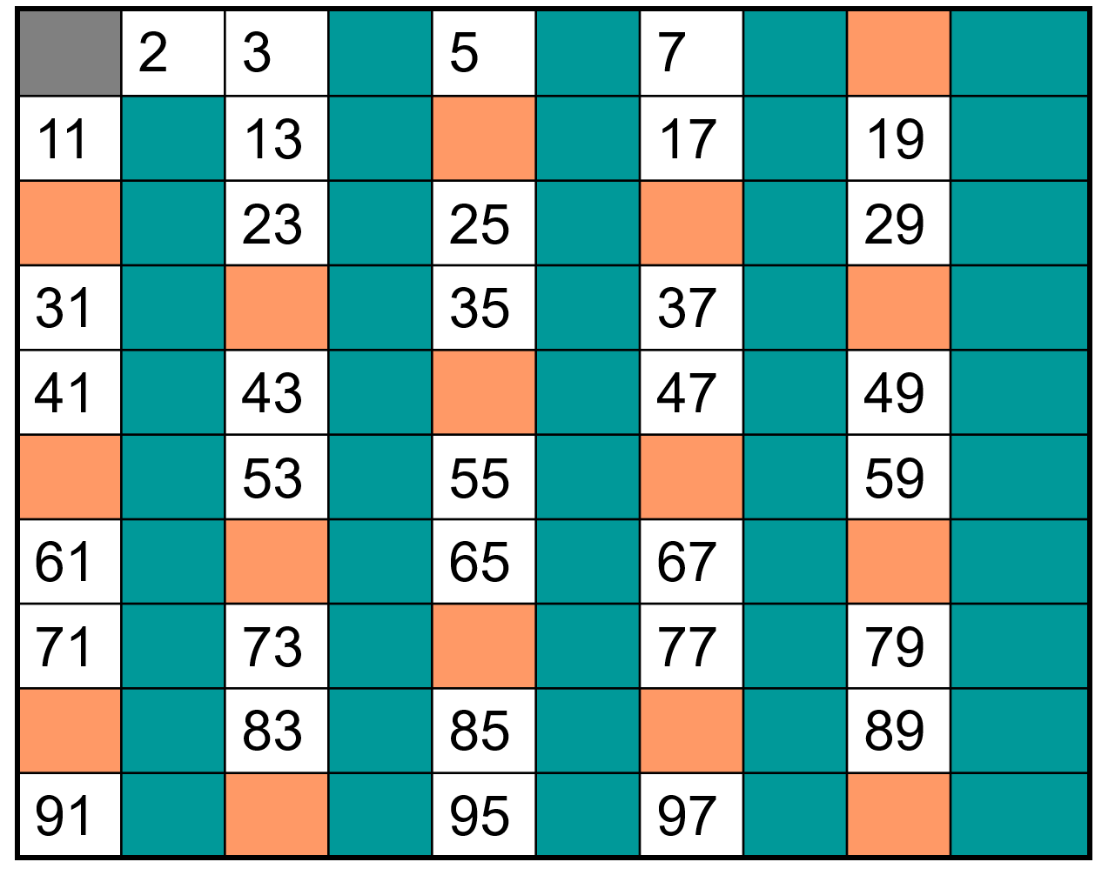
Sieve of Eratosthenes
Take out numbers that are divisible by 3

Slide 8
Sieve of Eratosthenes
Take out numbers that are divisible by 5

Slide 9
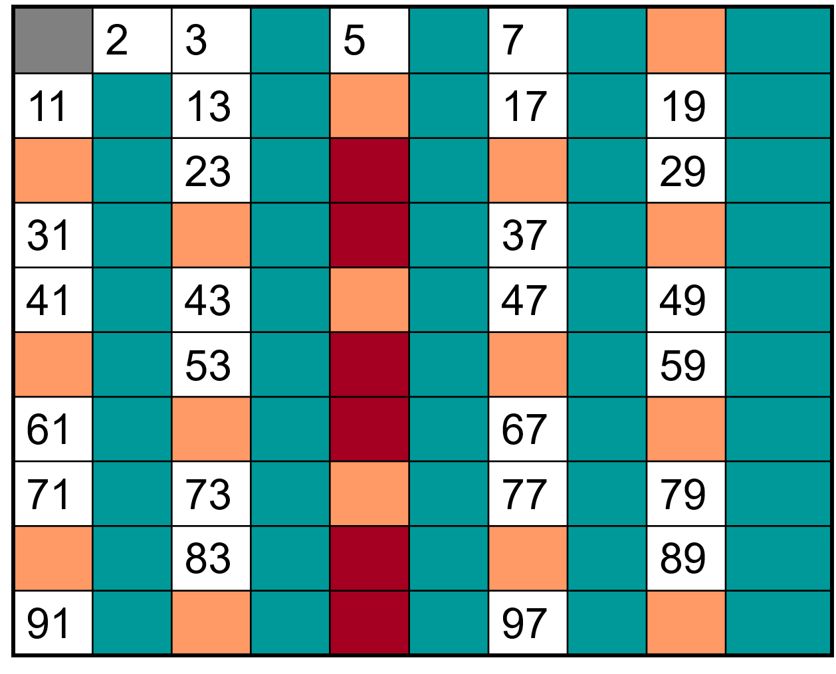
Sieve of Eratosthenes
Take out numbers that are divisible by 5

Slide 10
Sieve of Eratosthenes
Take out numbers that are divisible by 7

Slide 11
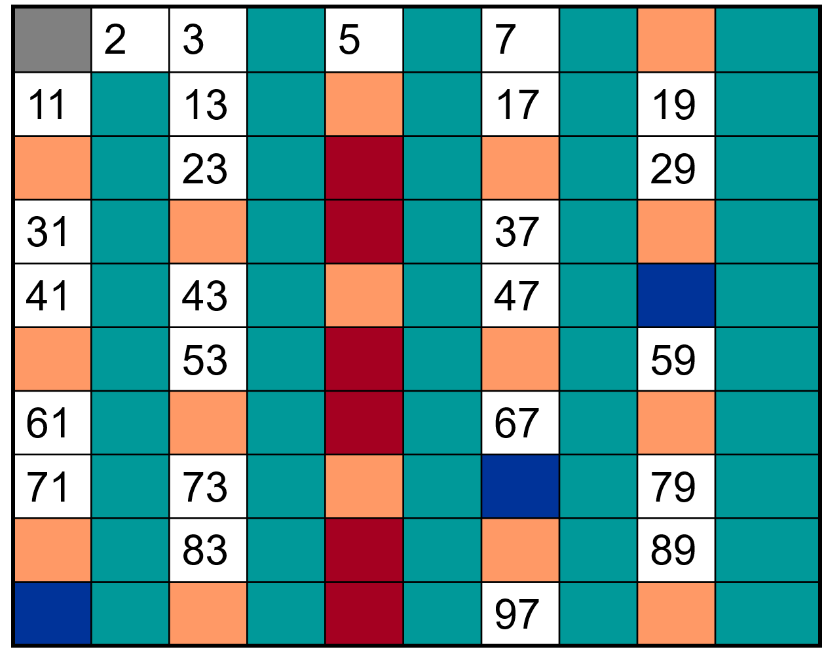
Sieve of Eratosthenes
Take out numbers that are divisible by 7

Slide 12
Sieve of Eratosthenes
All the numbers that are remaining are the prime numbers less than 100

Slide 13

Twin primes
These are a pair of prime numbers that differ by 2.
For example: 3 and 5.
$5 and 7$, 11 and 13, 17 and 19, 2027 and 2029
Largest known twin primes are 299686303489${5.2}^{666669}−1$ and 299686303489${5.2}^{666669}+1$
We don’t know how many twin primes are there, it is believed that there are infinitely many

Slide 14
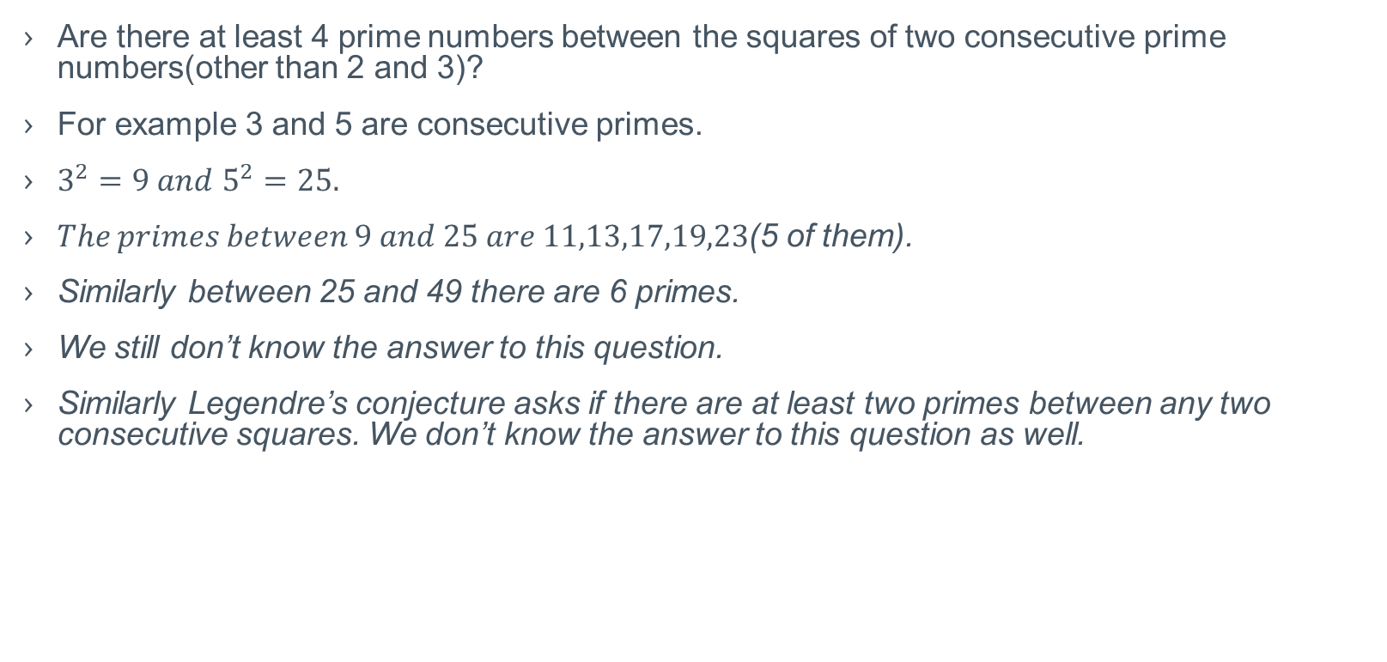
Brocard’s conjecture
Are there at least 4 prime numbers between the squares of two consecutive prime numbers(other than 2 and 3)?
For example 3 and 5 are consecutive primes.
$3^{2}=9 and$ $5^{2}=25.$
$The primes between 9 and 25 are 11,13,17,19,23$(5 of them).
Similarly between 25 and 49 there are 6 primes.
We still don’t know the answer to this question.
Similarly Legendre’s conjecture asks if there are at least two primes between any two consecutive squares. We don’t know the answer to this question as well.

Slide 15
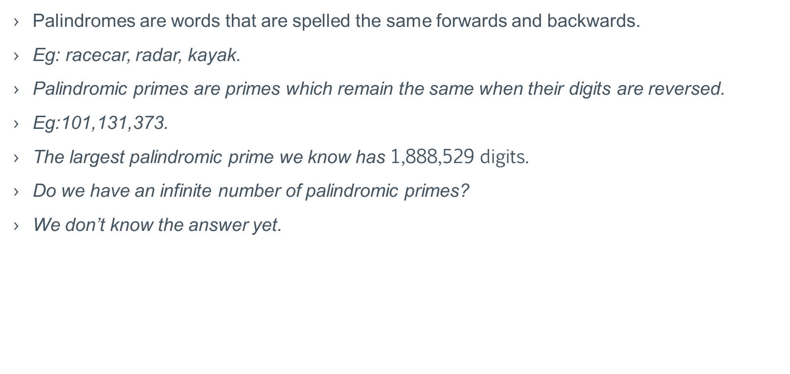
Palindromic primes
Palindromes are words that are spelled the same forwards and backwards.
Eg: racecar, radar, kayak.
Palindromic primes are primes which remain the same when their digits are reversed.
Eg:101,131,373.
The largest palindromic prime we know has 1,888,529 digits.
Do we have an infinite number of palindromic primes?
We don’t know the answer yet.

Slide 16
Goldbach’s conjectures
Every even integer greater than 2 can be written as sum of two primes
4=2+2, 6=3+3, 8=3+5
100=53+47=97+3=89+11=83+17=71+29=41+59

Slide 17
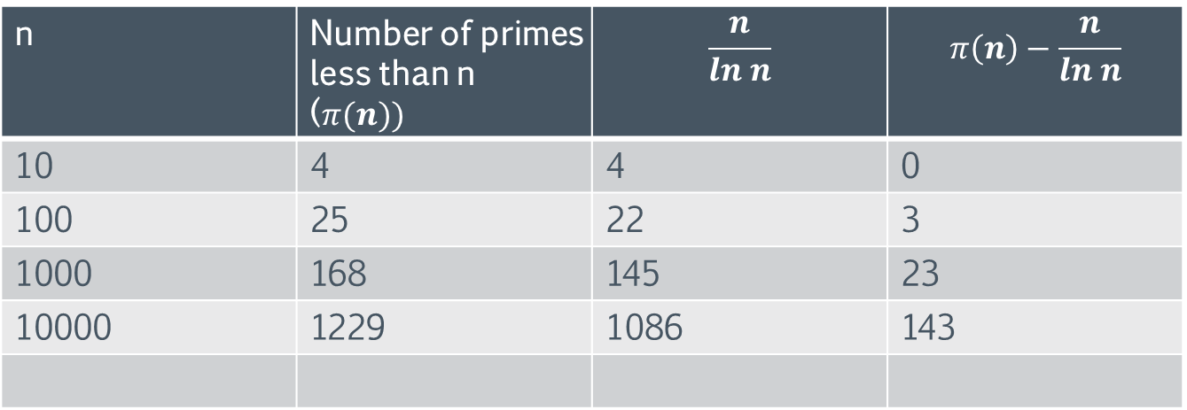
How many primes are there?
We know the answer to this question already. So we can ask how many primes are there less than n.
n | Number of primes less than n ($π(n))$ | $$\frac{n}{ln n}$$ | $$π\left(n\right)−\frac{n}{ln n}$$
10 | 4 | 4 | 0
100 | 25 | 22 | 3
1000 | 168 | 145 | 23
10000 | 1229 | 1086 | 143

Slide 18
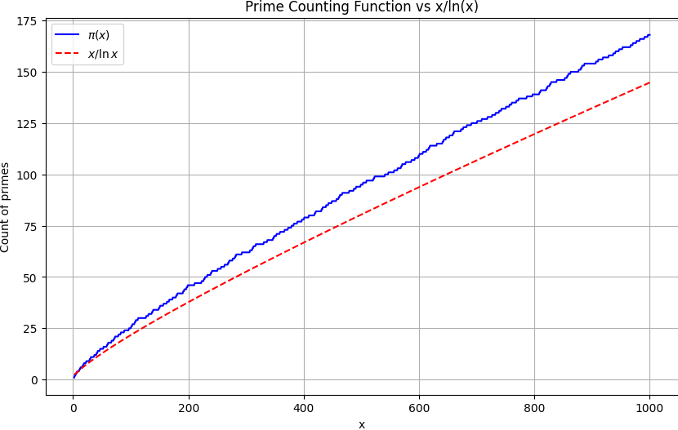

Slide 19
