Slide 1

The geometry of Spot it!
Travis Mandel

Slide 2
How to play
Each card has 8 pictures on it.
Each pair of cards have exactly one picture in common.
Players race to find which picture the cards have in common.

Slide 3

How to play

Slide 4
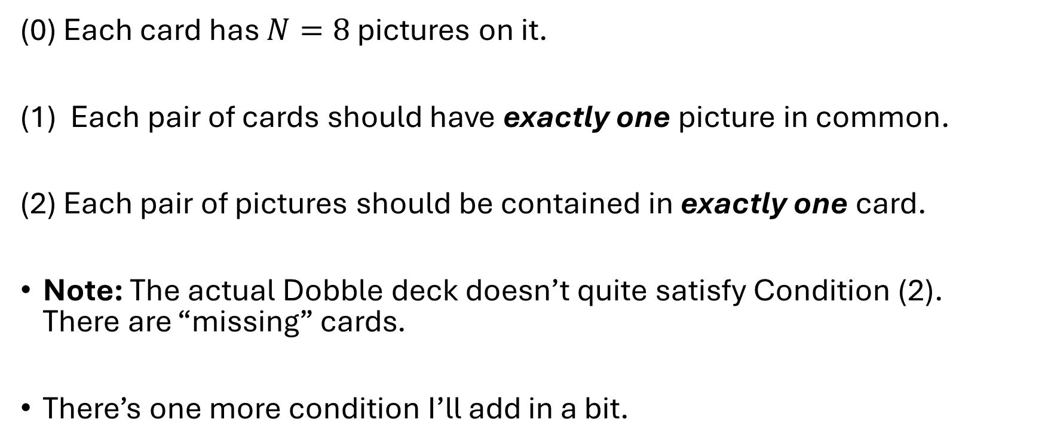
Conditions on a Dobble deck.
(0) Each card has $N=8$ pictures on it.
Each pair of cards should have exactly one picture in common.
(2) Each pair of pictures should be contained in exactly one card.
Note: The actual Dobble deck doesn’t quite satisfy Condition (2). There are “missing” cards.
There’s one more condition I’ll add in a bit.

Slide 5

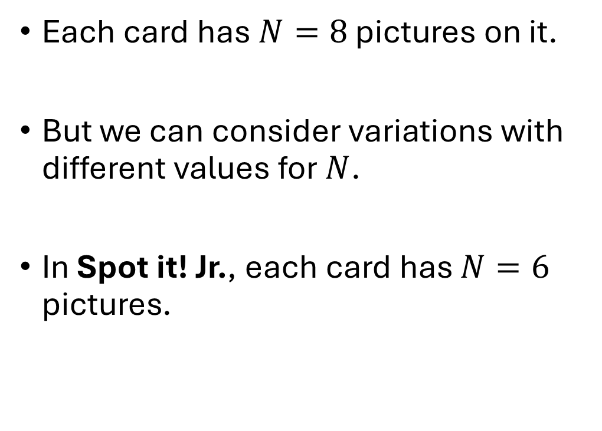
Varying the number of pictures
Each card has $N=8$ pictures on it.
But we can consider variations with different values for $N$.
In Spot it! Jr., each card has $N=6$ pictures.

Slide 6
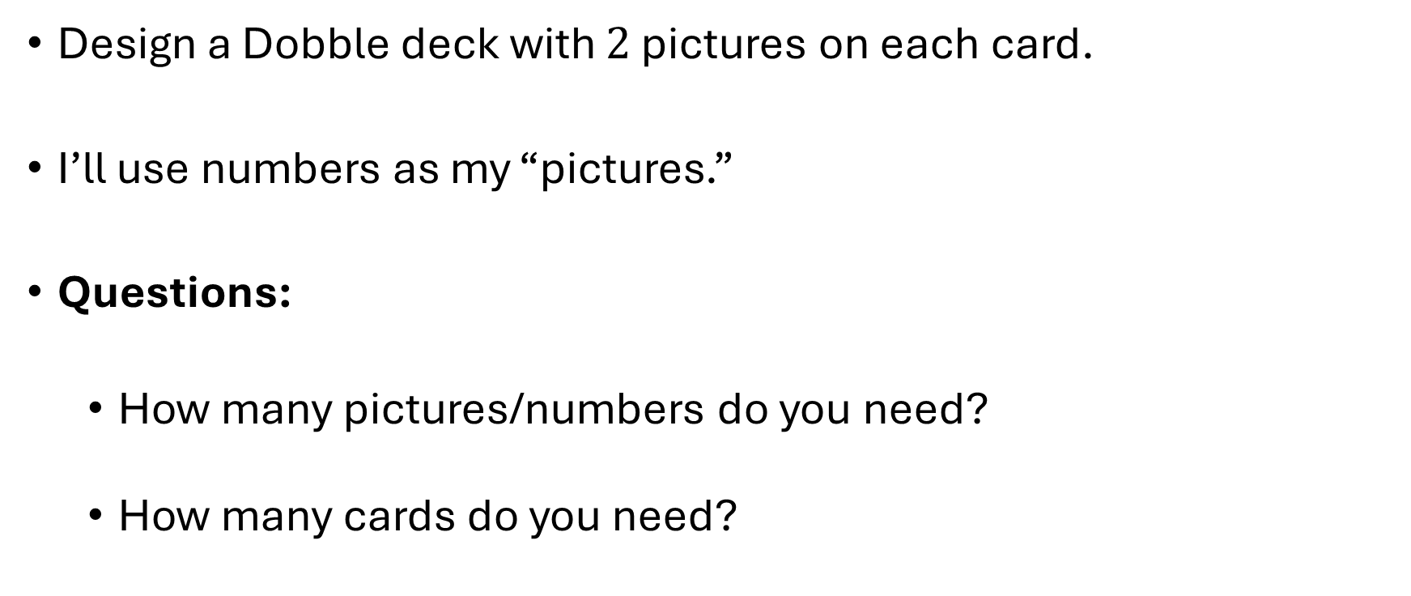

$$N=2$$
Design a Dobble deck with $2$ pictures on each card.
I’ll use numbers as my “pictures.”
Questions:
How many pictures/numbers do you need?
How many cards do you need?

Slide 7
$$N=2$$

Slide 8
$$N=2$$

Slide 9
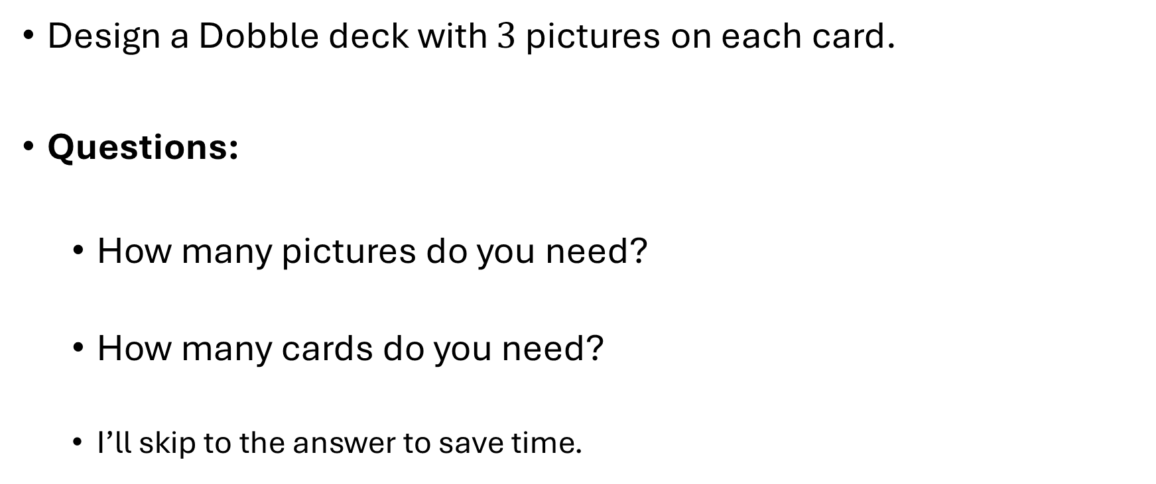

$$N=3$$
Design a Dobble deck with $3$ pictures on each card.
Questions:
How many pictures do you need?
How many cards do you need?
I’ll skip to the answer to save time.

Slide 10
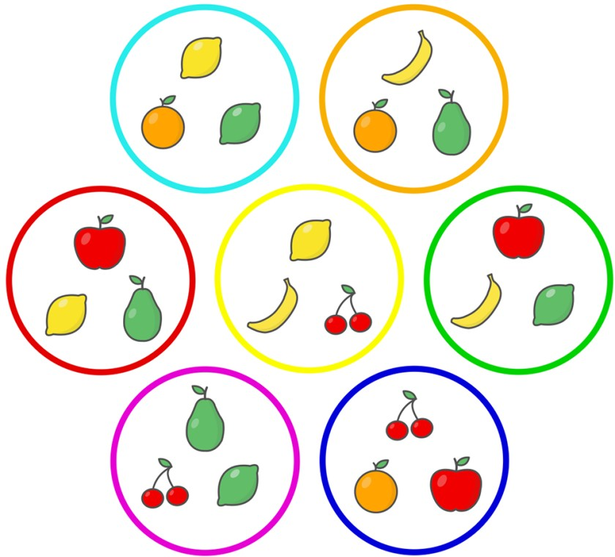
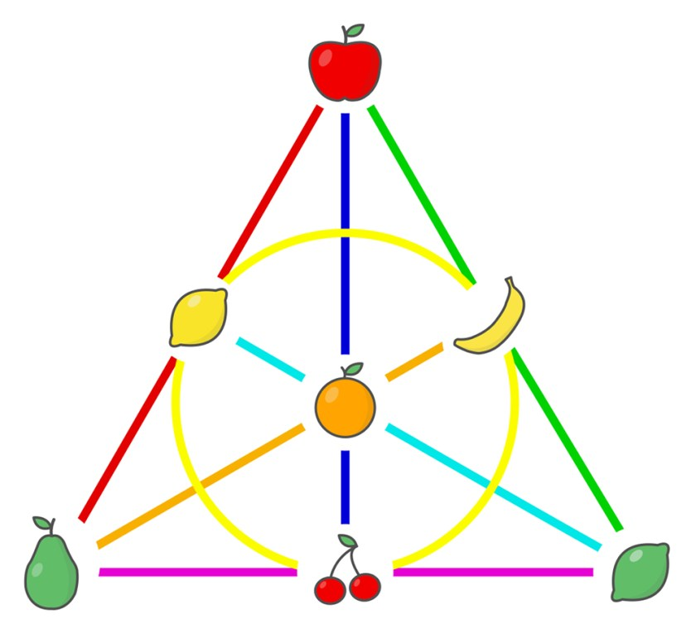
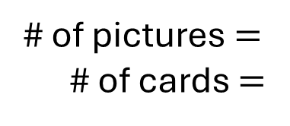
The Fano Plane and Spot it!
# of pictures $=$
# of cards $=$
Mathematicians call this the Fano plane.

Slide 11
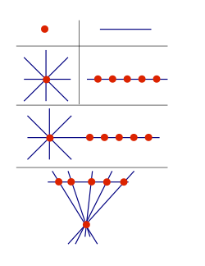
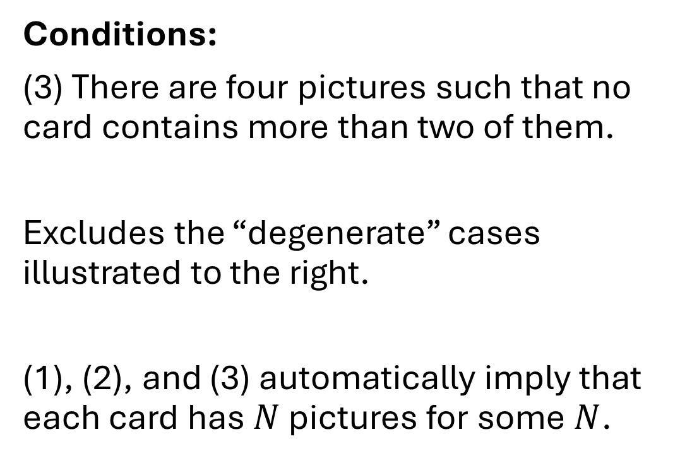
The non-degenerate condition
Conditions:
(3) There are four pictures such that no card contains more than two of them.
Excludes the “degenerate” cases illustrated to the right.
(1), (2), and (3) automatically imply that each card has $N$ pictures for some $N$.

Slide 12
Dobble and projective planes
A Dobble deck is a collection of pictures and cards such that
Each pair of cards should have exactly one picture in common.
(2) Each pair of pictures should have exactly one card in common.
(3) There are four pictures such that no card contains more than two of them.

Slide 13
Dobble and projective planes
A projective plane is a collection of points and lines such that
Each pair of lines should have exactly one point in common.
(2) Each pair of points should have exactly one line in common.
(3) There are four points such that no line contains more than two of them.

Slide 14
Dobble and projective planes
So a projective plane is a Dobble deck where we:
Think of the pictures as points, and
Think of the cards as lines.

Slide 15



$$N=∞$$
What if we actually use all points and lines in the $xy$-plane?

Slide 16
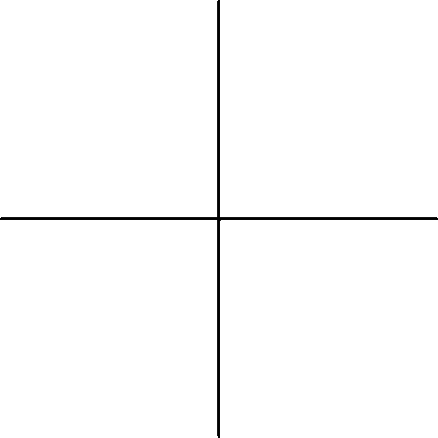
Are the conditions satisfied?
Each pair of lines should have exactly one point in common.
Each pair of points should have exactly one line in common.

Slide 17
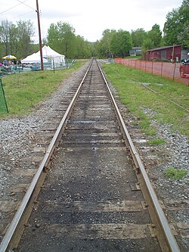
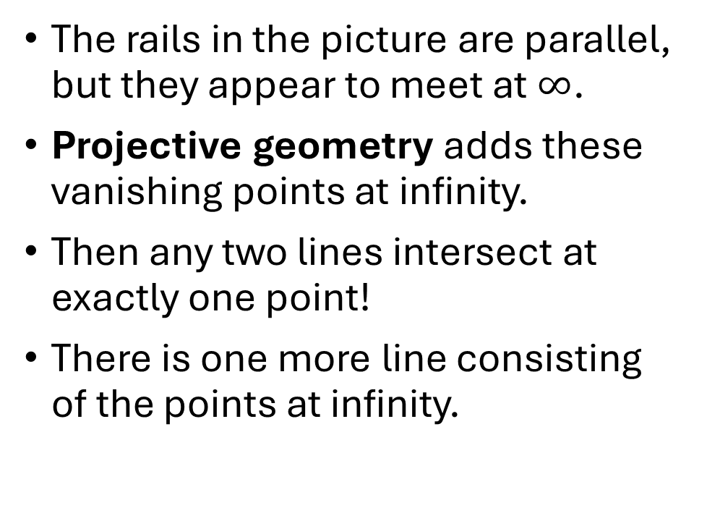
How to deal with parallel lines?
The rails in the picture are parallel, but they appear to meet at $∞$.
Projective geometry adds these vanishing points at infinity.
Then any two lines intersect at exactly one point!
There is one more line consisting of the points at infinity.

Slide 18
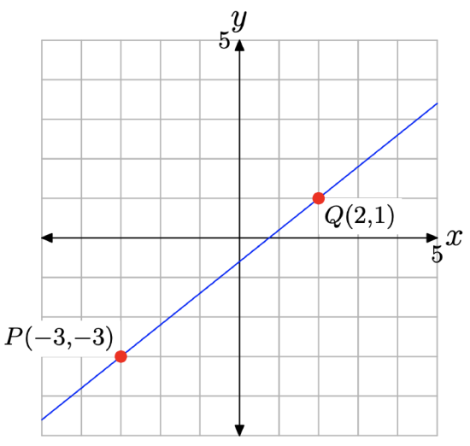
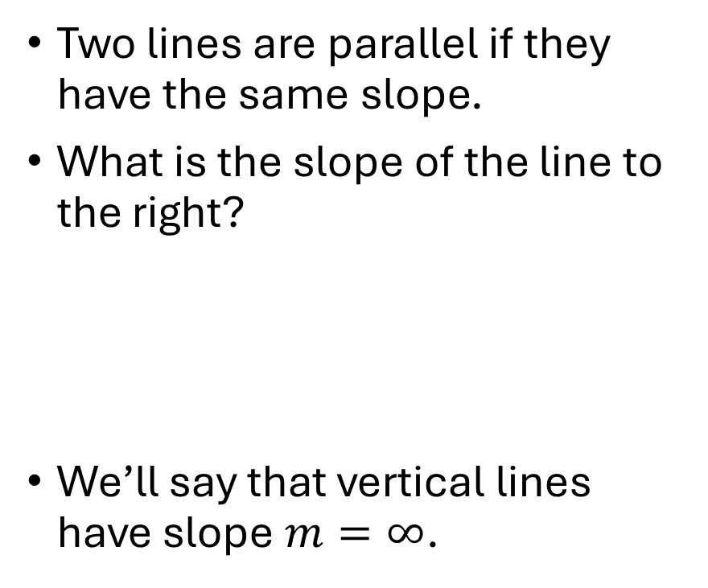
Slope
Two lines are parallel if they have the same slope.
What is the slope of the line to the right?
We’ll say that vertical lines have slope $m=∞$.

Slide 19
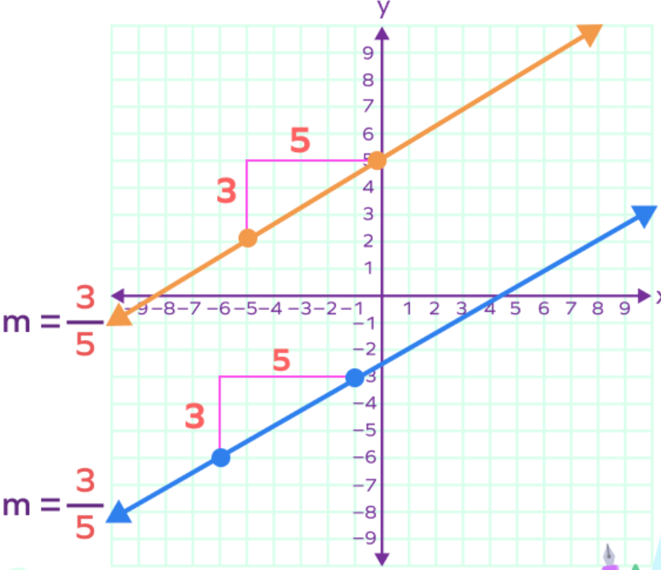
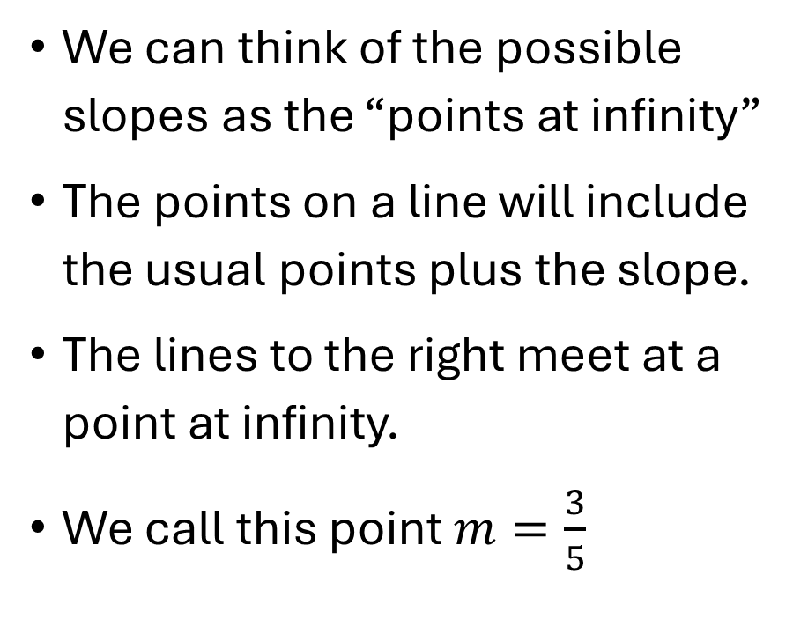
Slopes as points at infinity.
We can think of the possible slopes as the “points at infinity”
The points on a line will include the usual points plus the slope.
The lines to the right meet at a point at infinity.
We call this point $m=\frac{3}{5}$

Slide 20
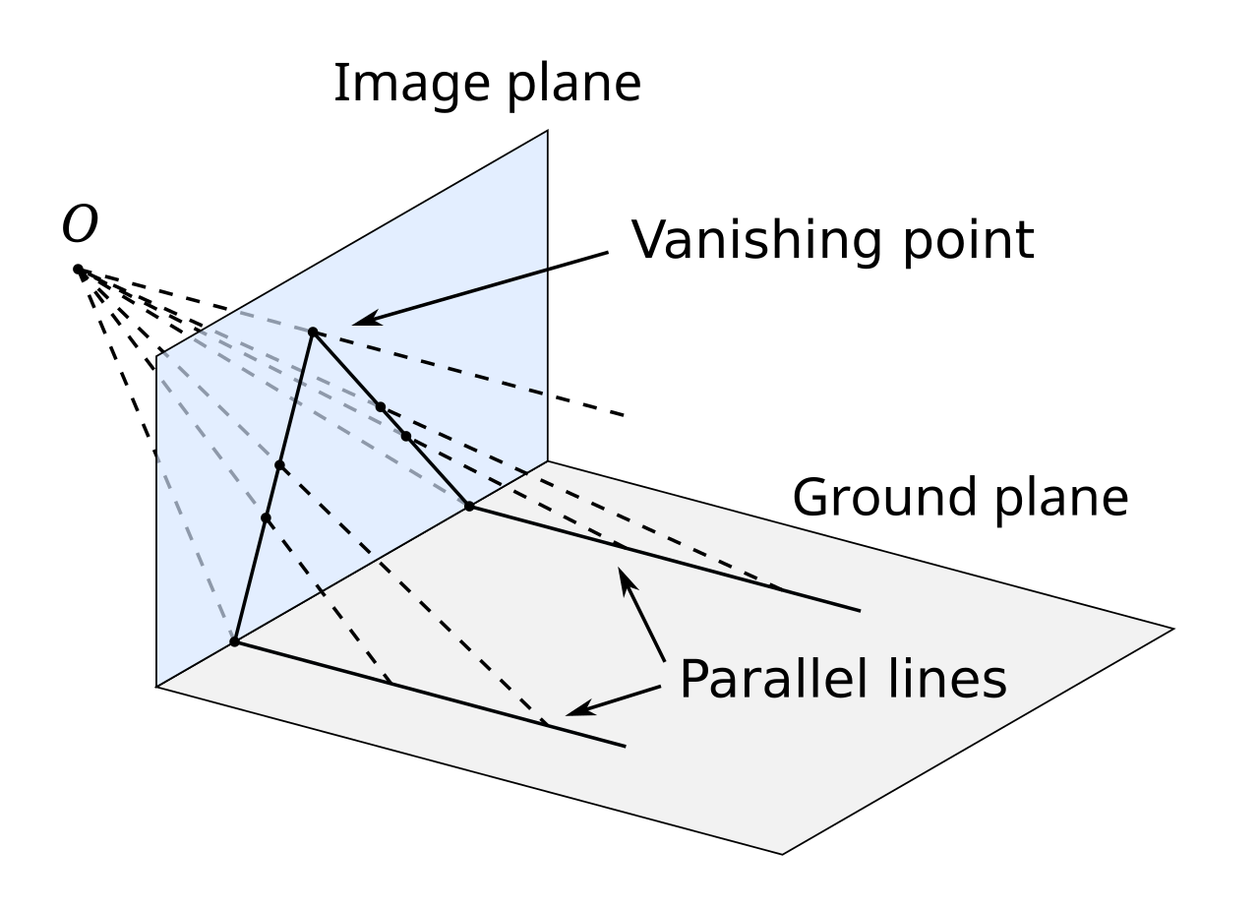
Projective geometry
Projective geometry is what you get when you project 3d-space onto a 2d-surface.

Slide 21
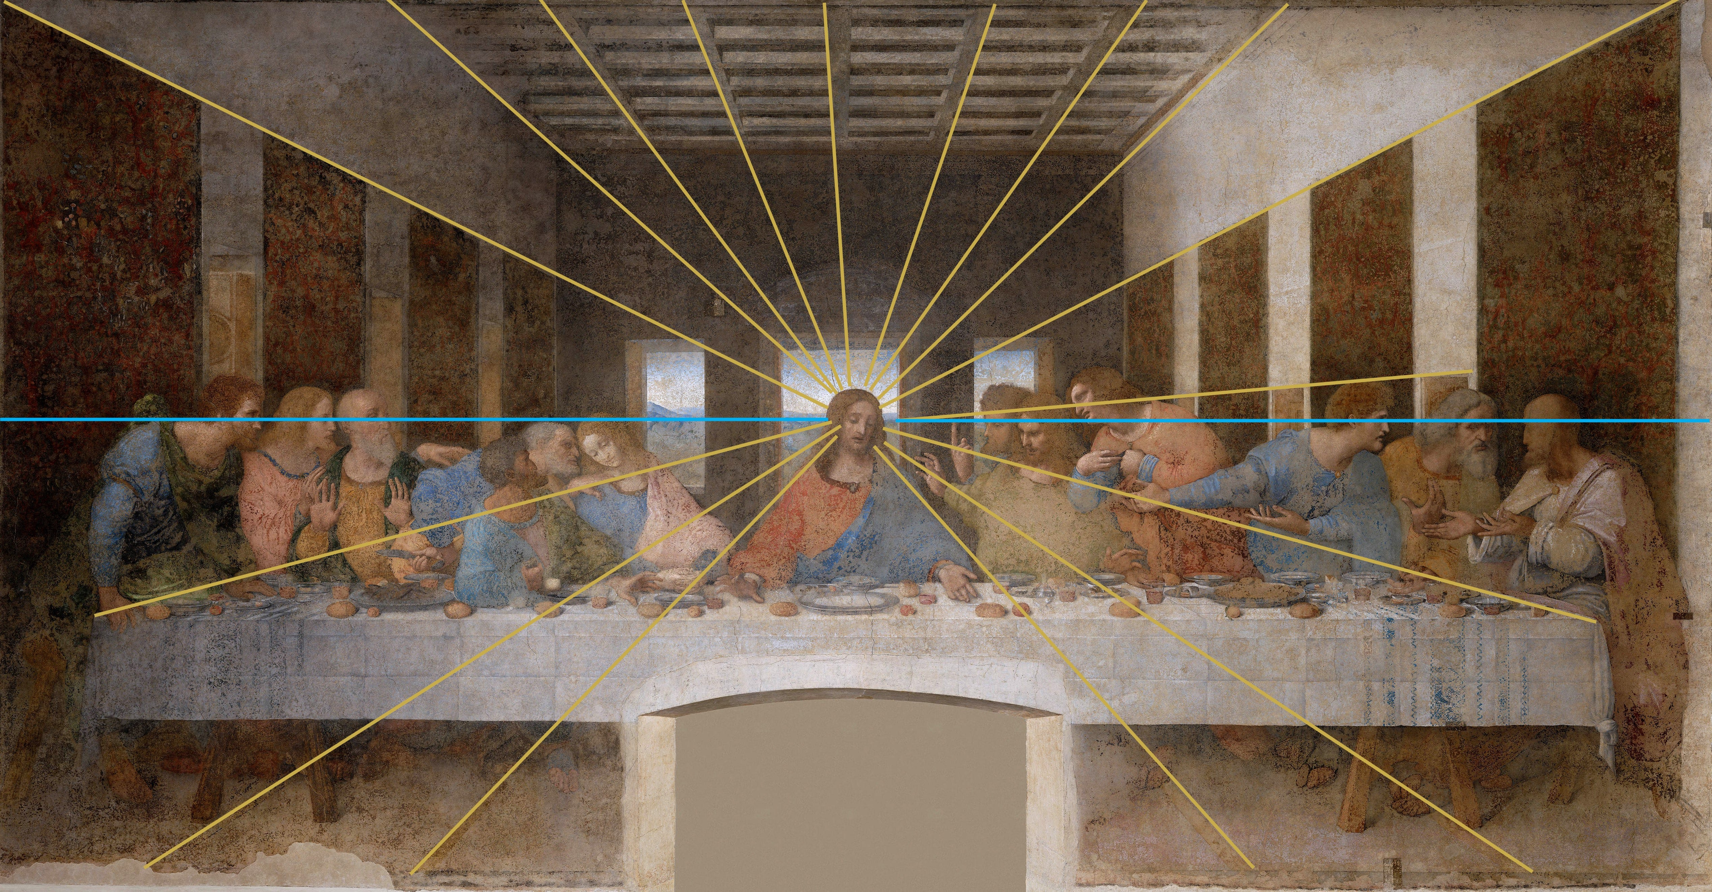
Vanishing points in art

Slide 22
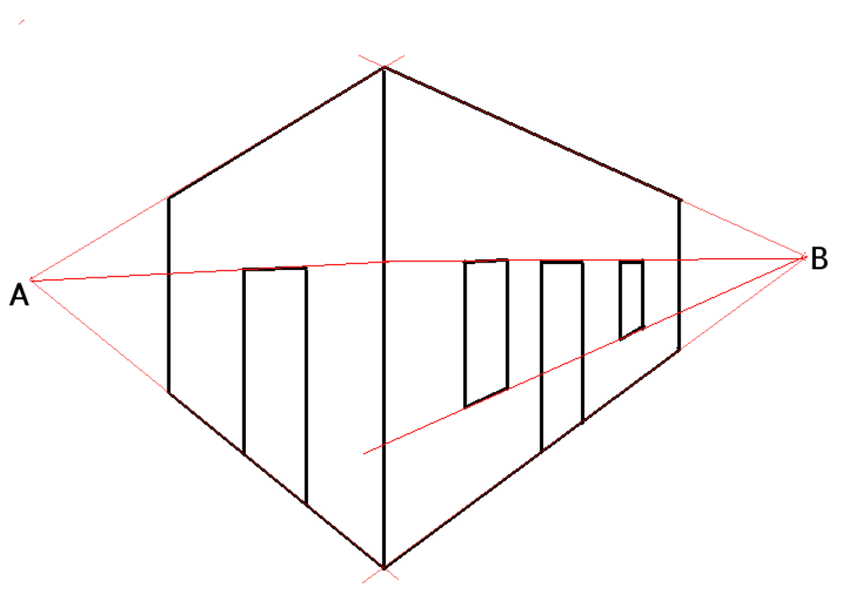
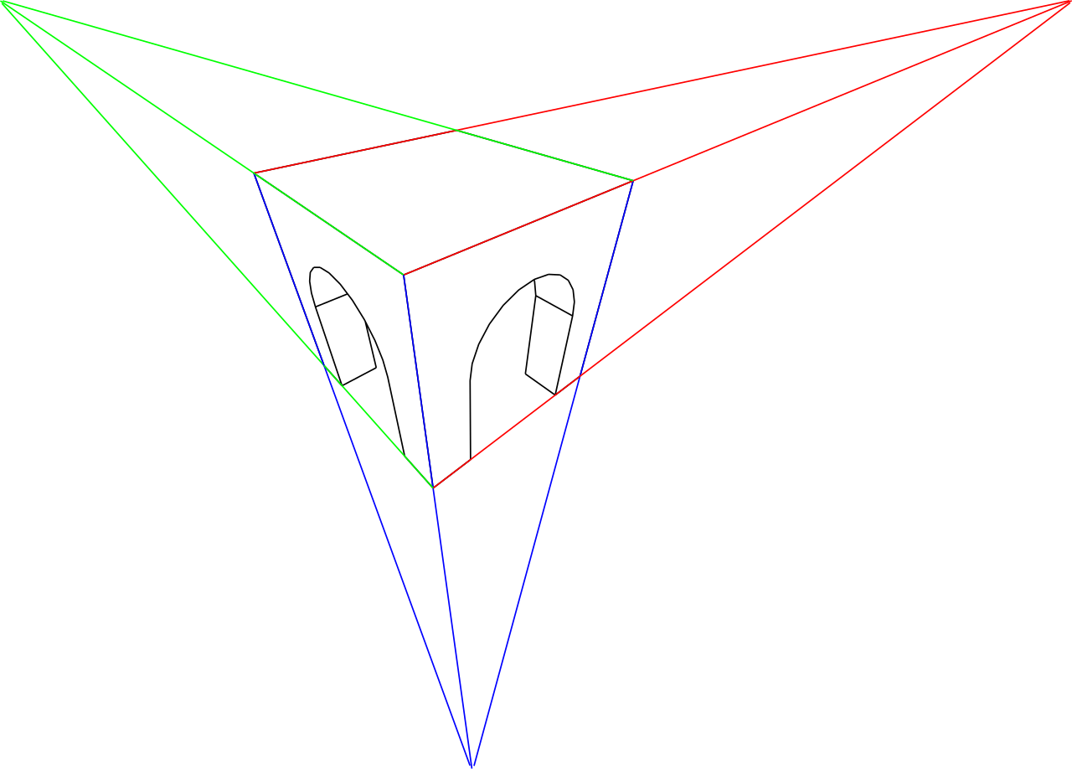
Lines with different slopes have different vanishing points

Slide 23
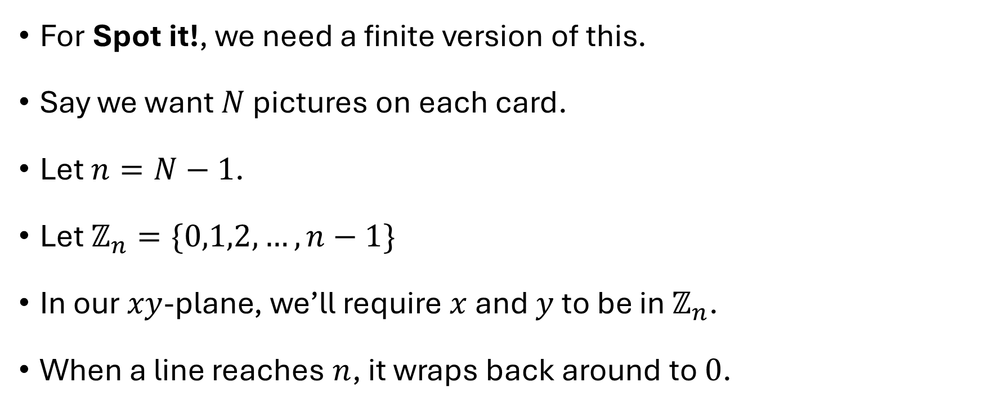
Finite projective planes
For Spot it!, we need a finite version of this.
Say we want $N$ pictures on each card.
Let $n=N−1$.
Let $ℤ_{n}=\{0,1,2,…,n−1\}$
In our $xy$-plane, we’ll require $x$ and $y$ to be in $ℤ_{n}$.
When a line reaches $n$, it wraps back around to $0$.

Slide 24


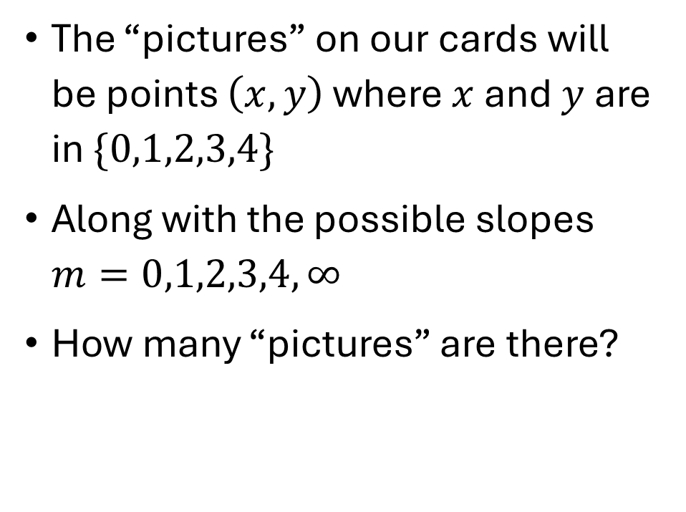
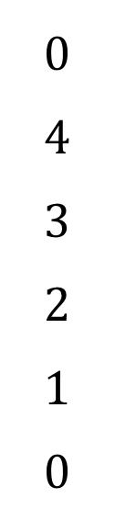
$$N=6 , (n=5)$$
$$0$$
$$4$$
$$3$$
$$2$$
$$1$$
$$0$$
The “pictures” on our cards will be points $\left(x,y\right)$ where $x$ and $y$ are in $\{0,1,2,3,4\}$
Along with the possible slopes $m=0,1,2,3,4,∞$
How many “pictures” are there?
$$0 1 2 3 4 0$$

Slide 25

$$N=6 , (n=5)$$
$$0$$
$$4$$
$$3$$
$$2$$
$$1$$
$$0$$
Which points are on the line through $(0,1)$ and $(1,4)$?
Compare this with the line though $(0,1)$ and $(2,2)$.
$$0 1 2 3 4 0$$
$$0 1 2 3 4 0$$

Slide 26
$$N=6 , (n=5)$$
$$0$$
$$4$$
$$3$$
$$2$$
$$1$$
$$0$$
We said there are _______ points.
How many lines are there?
$$0 1 2 3 4 0$$

Slide 27
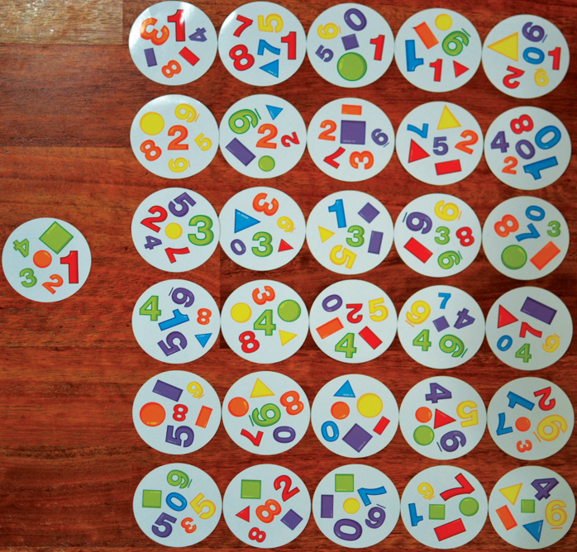
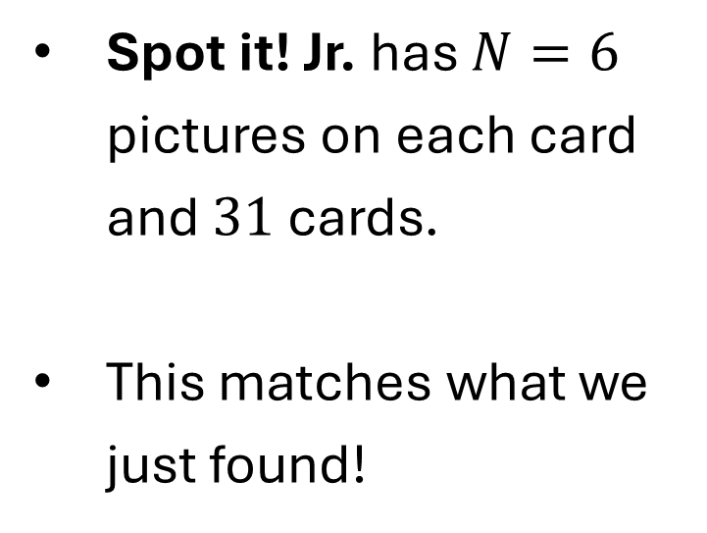
Spot it! Jr.
Spot it! Jr. has $N=6$ pictures on each card and $31$ cards.
This matches what we just found!

Slide 28









The projective plane over $ℤ_{2}$ $(N=3)$
List of points
List of “cards”
$$0$$
$$1$$
$$0$$
$$0$$
$$1$$
$$0$$

Slide 29









The projective plane over $ℤ_{3}$ ($N=4$)
Points
Cards
$$2$$
$$1$$
$$0$$
$$0$$
$$1$$
$$2$$

Slide 30
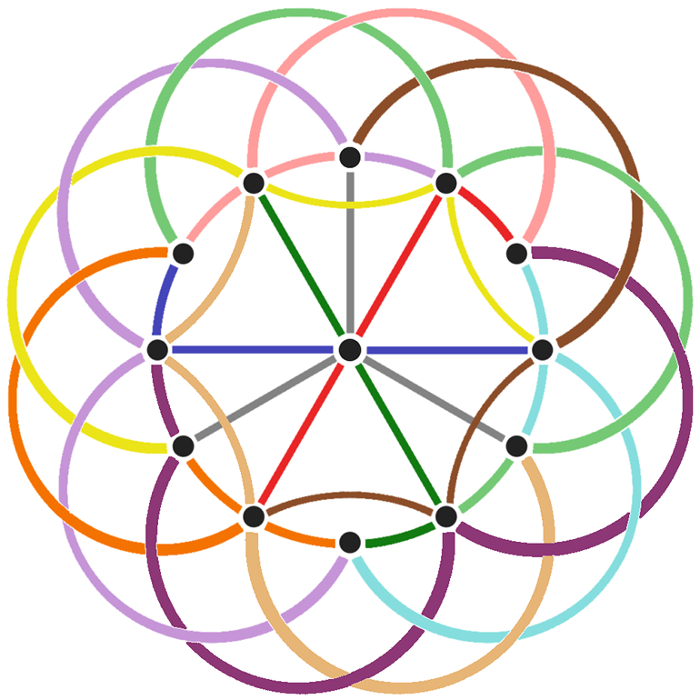

Slide 31









Something goes wrong with $ℤ_{4}$
Can you find two lines that don’t intersect?
Can you find two lines that intersect at multiple points?
$$3$$
$$2$$
$$1$$
$$0$$
$$0$$
$$1$$
$$2$$
$$3$$

Slide 32


Multiplication in $ℤ_{n}$
In $ℤ_{7}$, what is $6⋅5$?
We know $6⋅5=30$, but this isn’t in $ℤ_{7}$
But $30=7⋅4+2$
The remainder is $2$.
So we say $6⋅5=2$ in $ℤ_{7}$

Slide 33
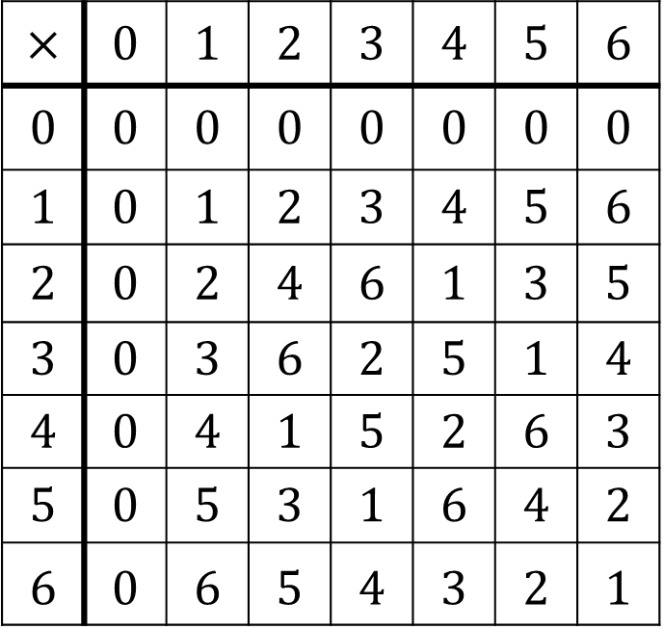


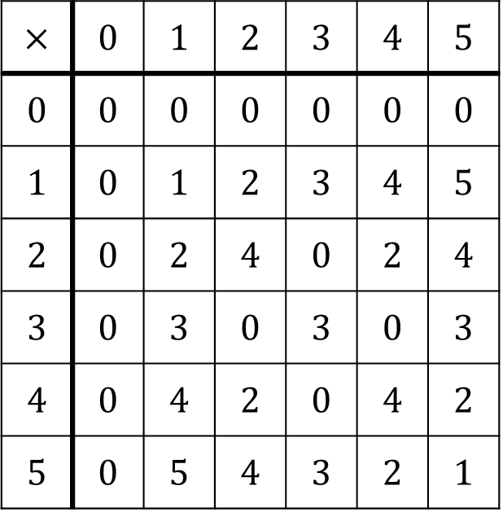
Multiplication in $ℤ_{n}$
$$ℤ_{7}$$
$$ℤ_{6}$$
$$×$$ | $$0$$ | $$1$$ | $$2$$ | $$3$$ | $$4$$ | $$5$$ | $$6$$
$$0$$ | $$0$$ | $$0$$ | $$0$$ | $$0$$ | $$0$$ | $$0$$ | $$0$$
$$1$$ | $$0$$ | $$1$$ | $$2$$ | $$3$$ | $$4$$ | $$5$$ | $$6$$
$$2$$ | $$0$$ | $$2$$ | $$4$$ | $$6$$ | $$1$$ | $$3$$ | $$5$$
$$3$$ | $$0$$ | $$3$$ | $$6$$ | $$2$$ | $$5$$ | $$1$$ | $$4$$
$$4$$ | $$0$$ | $$4$$ | $$1$$ | $$5$$ | $$2$$ | $$6$$ | $$3$$
$$5$$ | $$0$$ | $$5$$ | $$3$$ | $$1$$ | $$6$$ | $$4$$ | $$2$$
$$6$$ | $$0$$ | $$6$$ | $$5$$ | $$4$$ | $$3$$ | $$2$$ | $$1$$
$$×$$ | $$0$$ | $$1$$ | $$2$$ | $$3$$ | $$4$$ | $$5$$
$$0$$ | $$0$$ | $$0$$ | $$0$$ | $$0$$ | $$0$$ | $$0$$
$$1$$ | $$0$$ | $$1$$ | $$2$$ | $$3$$ | $$4$$ | $$5$$
$$2$$ | $$0$$ | $$2$$ | $$4$$ | $$0$$ | $$2$$ | $$4$$
$$3$$ | $$0$$ | $$3$$ | $$0$$ | $$3$$ | $$0$$ | $$3$$
$$4$$ | $$0$$ | $$4$$ | $$2$$ | $$0$$ | $$4$$ | $$2$$
$$5$$ | $$0$$ | $$5$$ | $$4$$ | $$3$$ | $$2$$ | $$1$$

Slide 34


We need $n$ to be prime.
If $n$ is not prime, we get $0$ as a product of nonzero numbers.
This leads to lines that intersect the wrong number of times.
We saw this in the $n=4$ case.

Slide 35
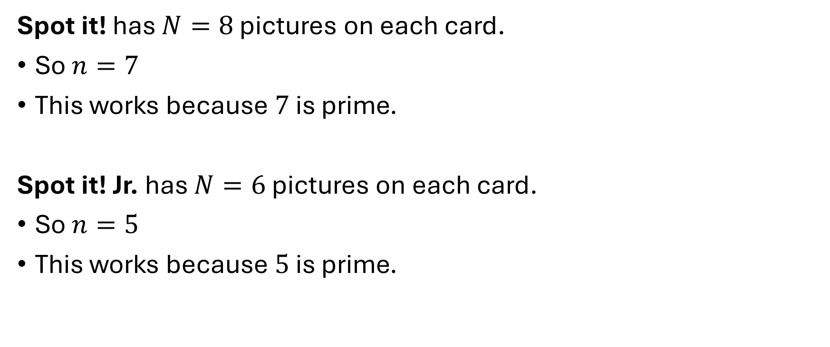
We need $n$ to be prime.
Spot it! has $N=8$ pictures on each card.
So $n=7$
This works because $7$ is prime.
Spot it! Jr. has $N=6$ pictures on each card.
So $n=5$
This works because $5$ is prime.

Slide 36

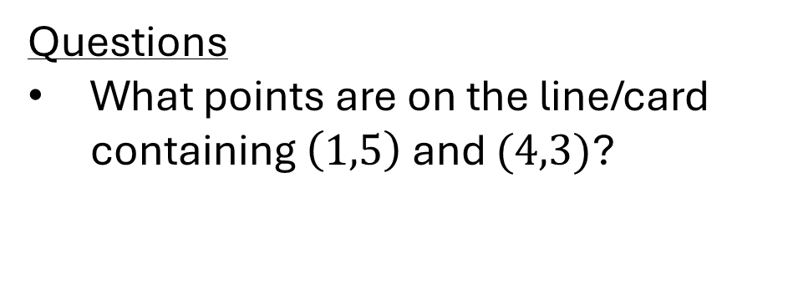


The Spot it! Deck: $N=8$
$$0$$
$$6$$
$$5$$
$$4$$
$$3$$
$$2$$
$$1$$
$$0$$
Questions
What points are on the line/card containing $\left(1,5\right)$ and $(4,3)$?
$$0 1 2 3 4 5 6 0$$

Slide 37
The Spot it! Deck: $N=8$
$$0$$
$$6$$
$$5$$
$$4$$
$$3$$
$$2$$
$$1$$
$$0$$
Questions
What points are on the line/card containing $\left(1,5\right)$ and $(4,3)$?
$$0 1 2 3 4 5 6 0$$

Slide 38
The Spot it! Deck: $N=8$
$$0$$
$$6$$
$$5$$
$$4$$
$$3$$
$$2$$
$$1$$
$$0$$
Questions
What points are on the line/card containing $\left(1,5\right)$ and $(4,3)$?
$$0 1 2 3 4 5 6 0$$

Slide 39
The Spot it! Deck: $N=8$
$$0$$
$$6$$
$$5$$
$$4$$
$$3$$
$$2$$
$$1$$
$$0$$
Questions
What points are on the line/card containing $\left(1,5\right)$ and $(4,3)$?
$$0 1 2 3 4 5 6 0$$

Slide 40
The Spot it! Deck: $N=8$
$$0$$
$$6$$
$$5$$
$$4$$
$$3$$
$$2$$
$$1$$
$$0$$
Questions
What points are on the line/card containing $\left(1,5\right)$ and $(4,3)$?
$$0 1 2 3 4 5 6 0$$

Slide 41
The Spot it! Deck: $N=8$
$$0$$
$$6$$
$$5$$
$$4$$
$$3$$
$$2$$
$$1$$
$$0$$
Questions
What points are on the line/card containing $\left(1,5\right)$ and $(4,3)$?
$$0 1 2 3 4 5 6 0$$

Slide 42
The Spot it! Deck: $N=8$
$$0$$
$$6$$
$$5$$
$$4$$
$$3$$
$$2$$
$$1$$
$$0$$
Questions
What points are on the line/card containing $\left(1,5\right)$ and $(4,3)$?
$$0 1 2 3 4 5 6 0$$

Slide 43
The Spot it! Deck: $N=8$
$$0$$
$$6$$
$$5$$
$$4$$
$$3$$
$$2$$
$$1$$
$$0$$
Questions
How many total points are there?
How many lines/cards are there?
$$0 1 2 3 4 5 6 0$$

Slide 44
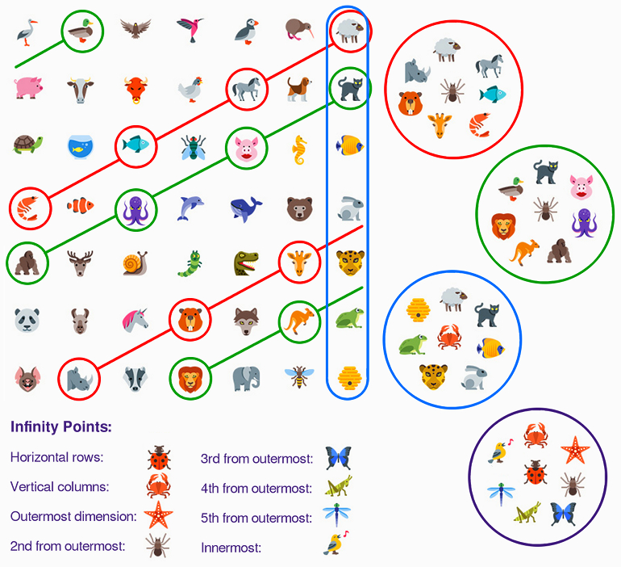

Slide 45
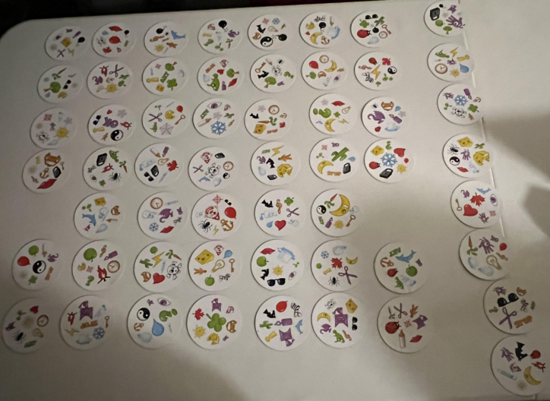




A real Spot it! deck contains $55$ cards.
The $2$ “missing” cards

Slide 46
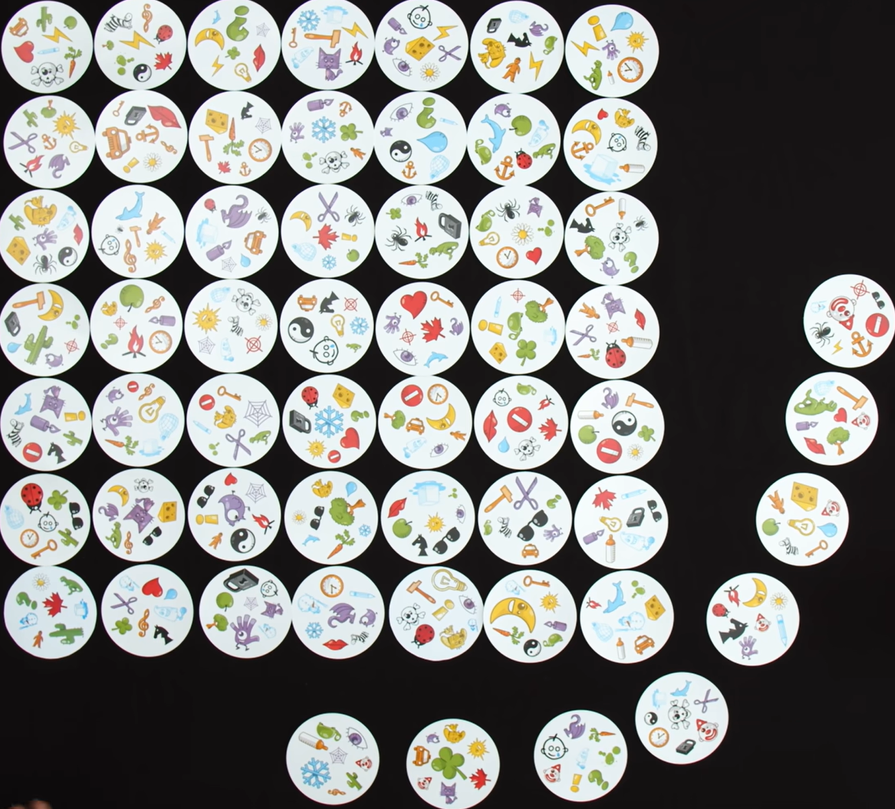
Duality between pictures and cards
We can think of the points as cards and think of the lines as pictures.

Slide 47


What happens when $n$ is not prime?
A similar technique works if $n$ is a power of a prime.
For example, $n=4=2^{2}$ works because it’s a power of a prime.
So you can make a Dobble deck with $N=5$ pictures on each card.
But we need something more complicated than $ℤ_{4}$.

Slide 48
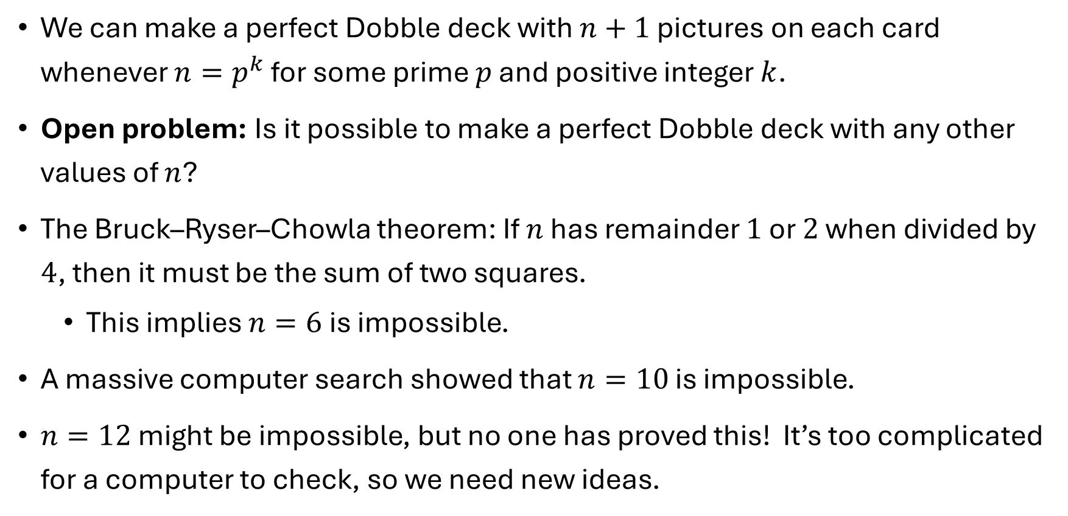
Conclusion
We can make a perfect Dobble deck with $n+1$ pictures on each card whenever $n=p^{k}$ for some prime $p$ and positive integer $k$.
Open problem: Is it possible to make a perfect Dobble deck with any other values of $n$?
The Bruck–Ryser–Chowla theorem: If $n$ has remainder $1$ or $2$ when divided by $4$, then it must be the sum of two squares.
This implies $n=6$ is impossible.
A massive computer search showed that $n=10$ is impossible.
$n=12$ might be impossible, but no one has proved this! It’s too complicated for a computer to check, so we need new ideas.

Slide 49
References
The math behind Spot It!
SpotItPuzzleEdited.pdf
Projective plane – Wikipedia
Jamie Mulholland – SFU
Finite Projective Planes and the Math of Spot It! – puzzlewocky
How does Dobble (Spot It) work? (YouTube)

