Slide 1
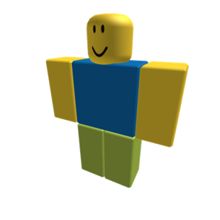
Arithmetic in base 2
Counting like a noob

Slide 2


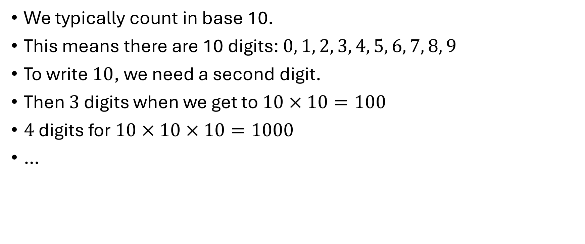






Base 10
We typically count in base 10.
This means there are 10 digits: $0, 1, 2, 3, 4, 5, 6, 7, 8, 9$
To write $10$, we need a second digit.
Then $3$ digits when we get to $10×10=100$
$4$ digits for $10×10×10=1000$
…

Slide 3
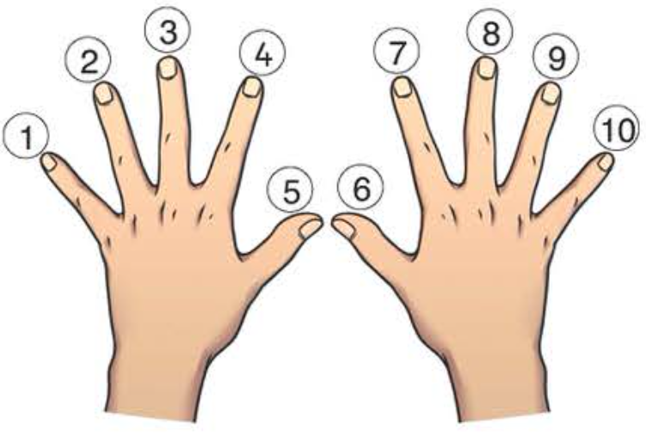

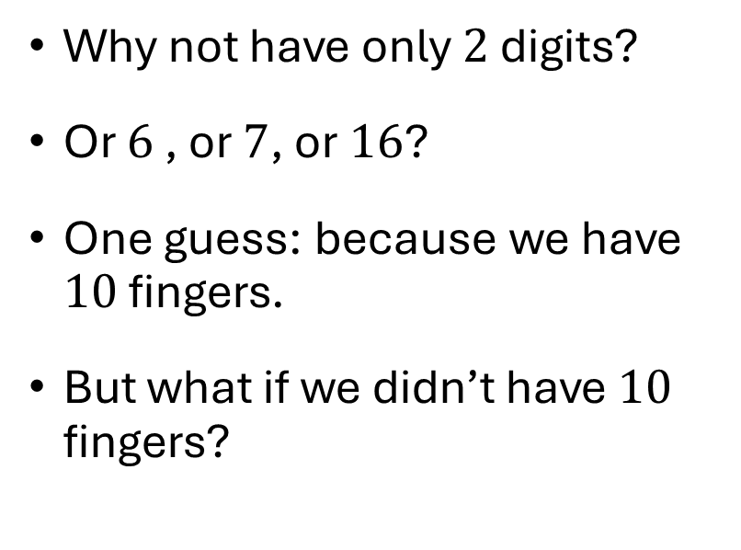
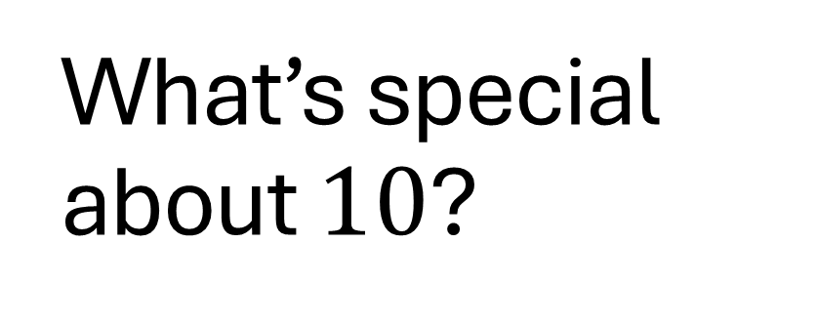

What’s special about $10$?
Why not have only $2$ digits?
Or $6$ , or $7$, or $16$?
One guess: because we have $10$ fingers.
But what if we didn’t have $10$ fingers?

Slide 4
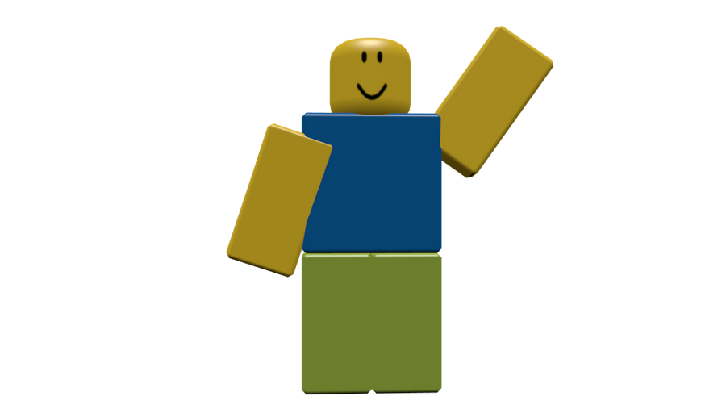


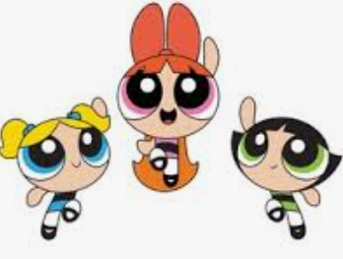
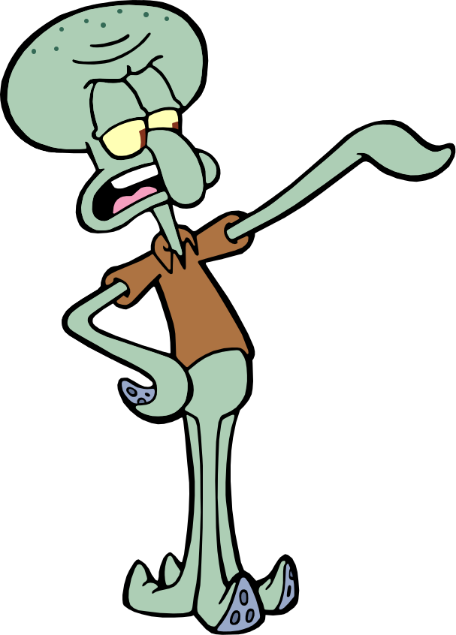
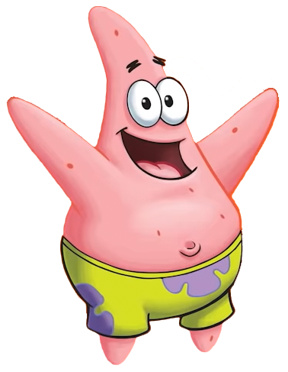



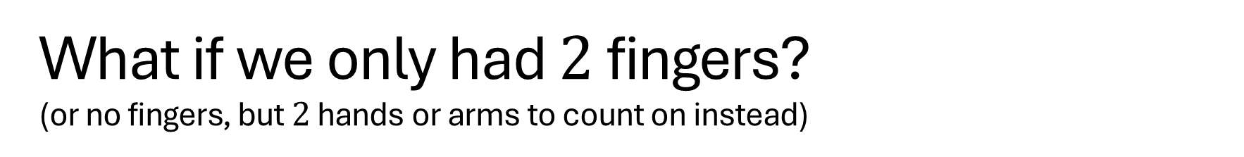
What if we only had $2$ fingers?
(or no fingers, but $2$ hands or arms to count on instead)

Slide 5


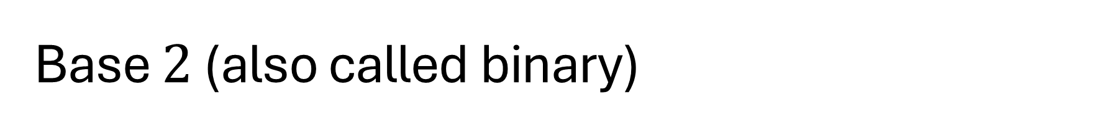



Base $2$ (also called binary)
Maybe we’d only have $2$ digits: $0$ and $1$.
  These are called bits (binary digits)
How would we count?
What comes after $1$?

Slide 6


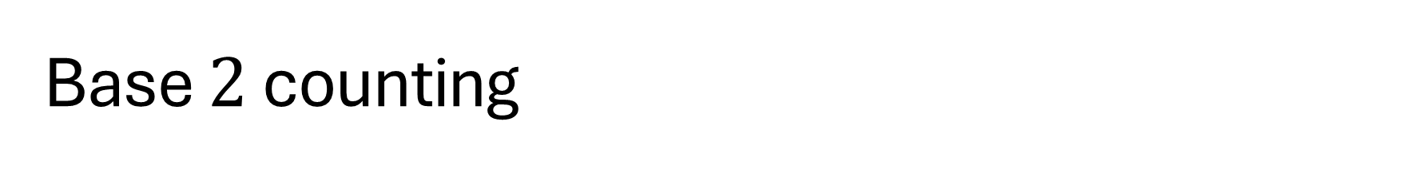

Base $2$ counting
$1$
$10$
Then what?

Slide 7

Base $2$ counting
$1$
$10$
$11$
Then what?

Slide 8

Base $2$ counting
$1$
$10$
$11$
$100$
Keep going! Count to $1000$.

Slide 9

Base $2$ counting
$1$
$10$
$11$
$100$
$101$

Slide 10

Base $2$ counting
$1$
$10$
$11$
$100$
$101$
$110$

Slide 11

Base $2$ counting
$1$
$10$
$11$
$100$
$101$
$110$
$111$

Slide 12

Base $2$ counting
$1$
$10$
$11$
$100$
$101$
$110$
$111$
$1000$

Slide 13
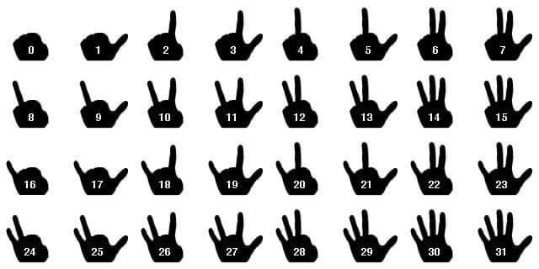




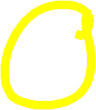
Counting on your fingers

Slide 14



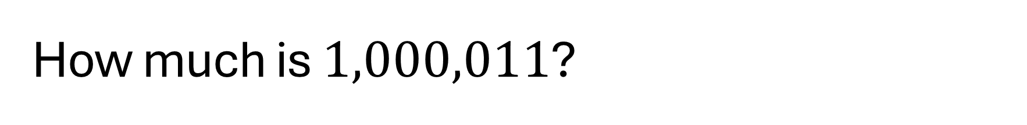

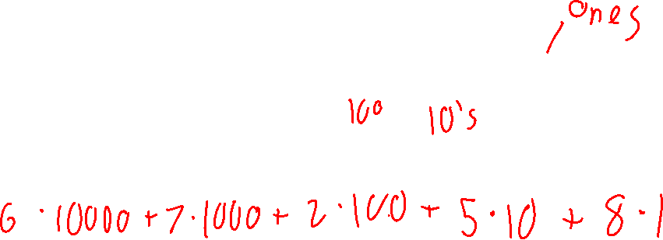

How much is $1,000,011$?
First think about base $10$.
What do the digits in $67,258$ represent?
$6 7, 2 5 8$
$6⋅{10}^{4} + 7⋅{10}^{3} + 2⋅{10}^{2} + 5⋅{10}^{1} + 8⋅{10}^{0}$

Slide 15

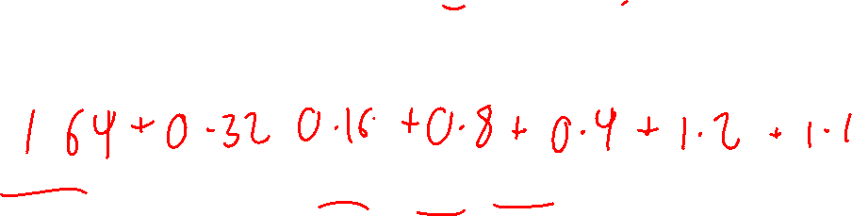
How much is $1,000,011$?
Base $2$ works similarly, but using powers of $2$.
$$1,000,011$$
$1⋅2^{6}+0⋅2^{5}+0⋅2^{4}+0⋅2^{3}+0⋅2^{2}+1⋅2^{1}+1⋅2^{0}$
$$64+2+1$$

Slide 16
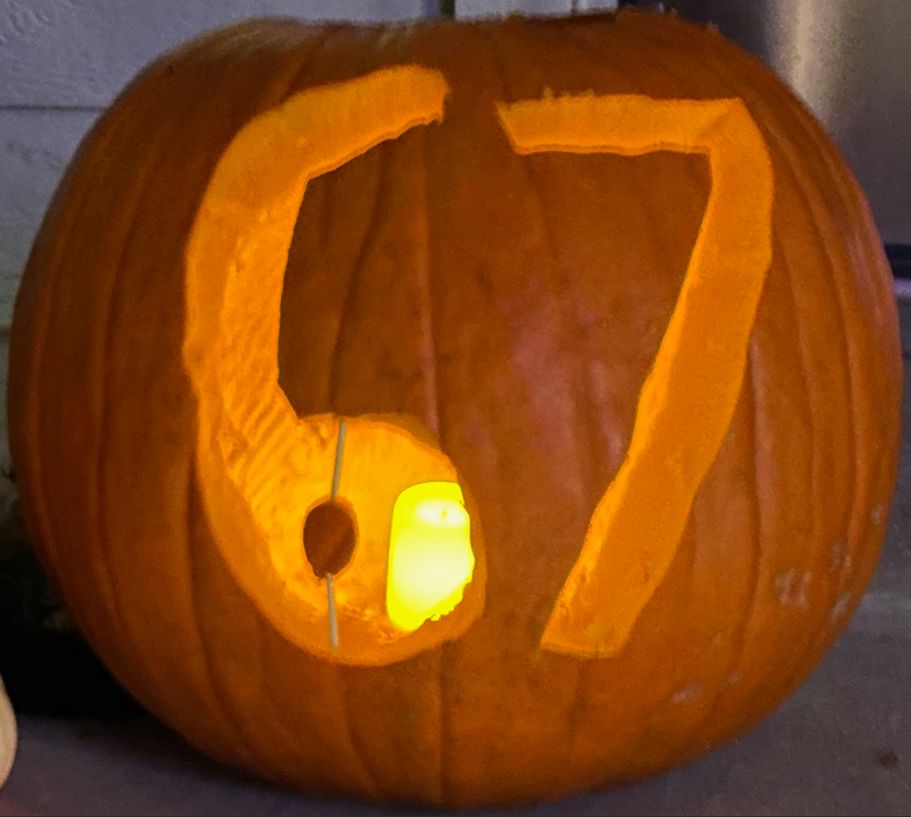

Slide 17
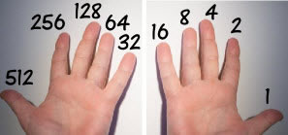
How high can you count on your fingers?

Slide 18


We could also do decimals
In base $2$
$0.1$ means $\frac{1}{2}$
$0.01$ means $\frac{1}{4}$
$0.001$ means $\frac{1}{8}$

Slide 19

A joke I’ve seen on t-shirts
There are $10$ kinds of people in the world. Those who understand binary and those who don’t.

Slide 20





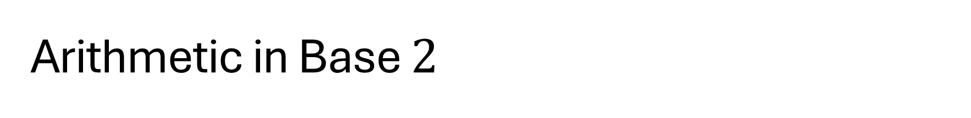




Arithmetic in Base $2$
Remember:
$$1+1=10$$
$$10+10=100$$
$$100+100=1000$$

Slide 21

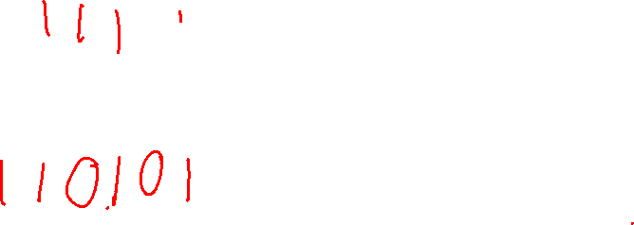
Arithmetic in Base $2$
Let’s compute $11,110+10,111$
$1 1 1 1 0$
$+ 1 0 1 1 1$

Slide 22
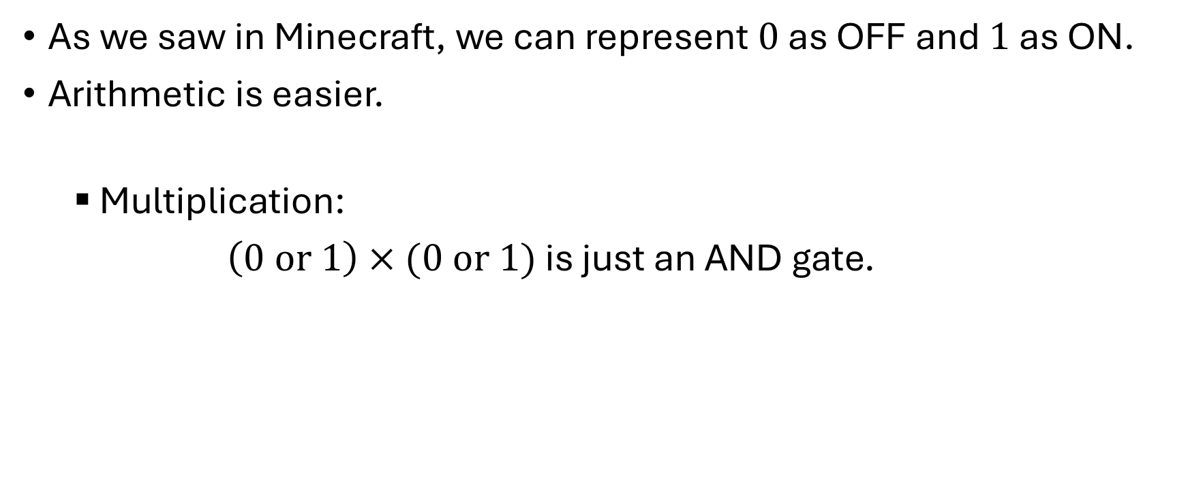
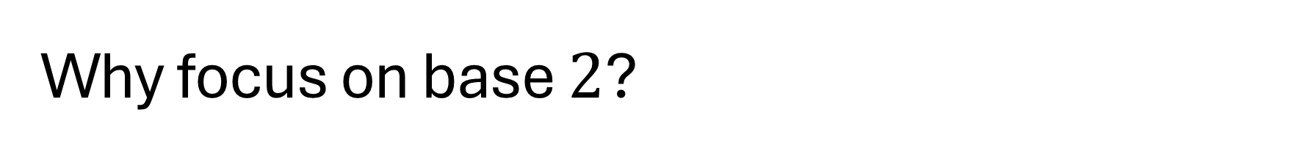
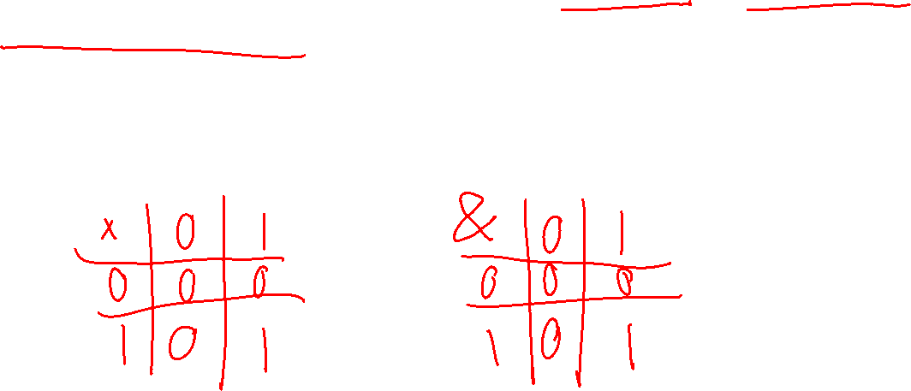
Why focus on base $2$?
As we saw in Minecraft, we can represent $0$ as OFF and $1$ as ON.
Arithmetic is easier.
  Multiplication:
$\left(0 \text{or} 1\right)×(0 \text{or} 1)$ is just an AND gate.

Slide 23
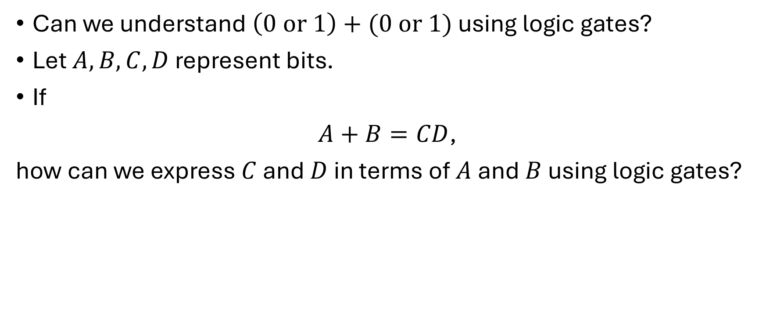
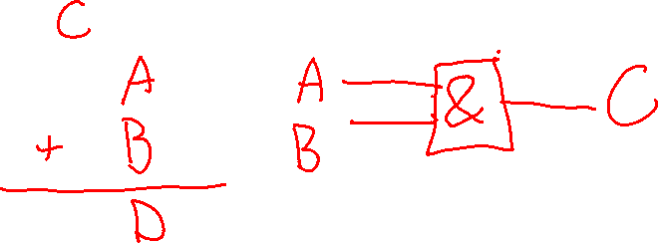
Gates for adding bits
Can we understand $\left(0 \text{or} 1\right)+(0 \text{or} 1)$ using logic gates?
Let $A,B,C,D$ represent bits.
If
$A+B=CD$,
how can we express $C$ and $D$ in terms of $A$ and $B$ using logic gates?

Slide 24
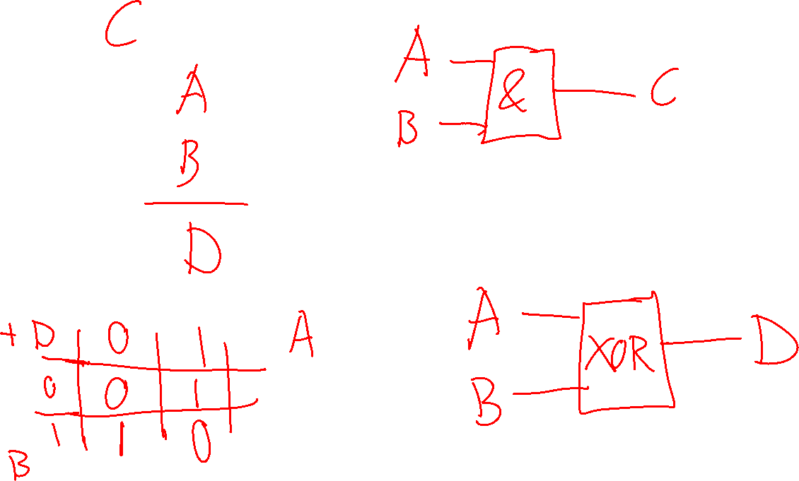

Slide 25
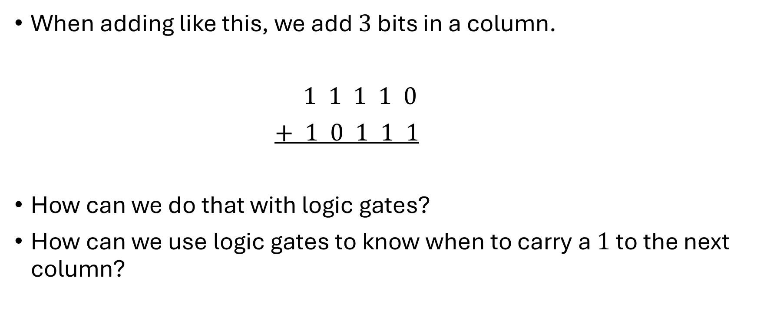
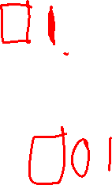
Gates for adding more bits
When adding like this, we add $3$ bits in a column.
$1 1 1 1 0$
$+ 1 0 1 1 1$
How can we do that with logic gates?
How can we use logic gates to know when to carry a $1$ to the next column?

Slide 26
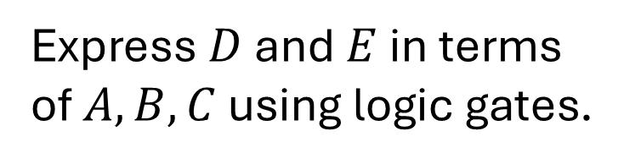
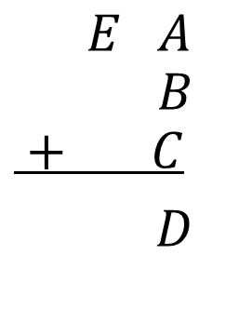
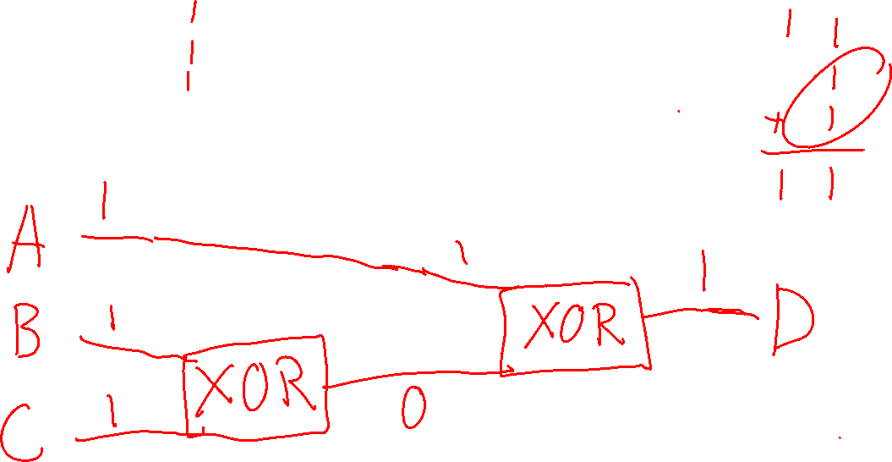
Gates for adding and carrying
$$E A$$
$$B$$
$$+ C$$
$D$
Express $D$ and $E$ in terms of $A,B,C$ using logic gates.

Slide 27
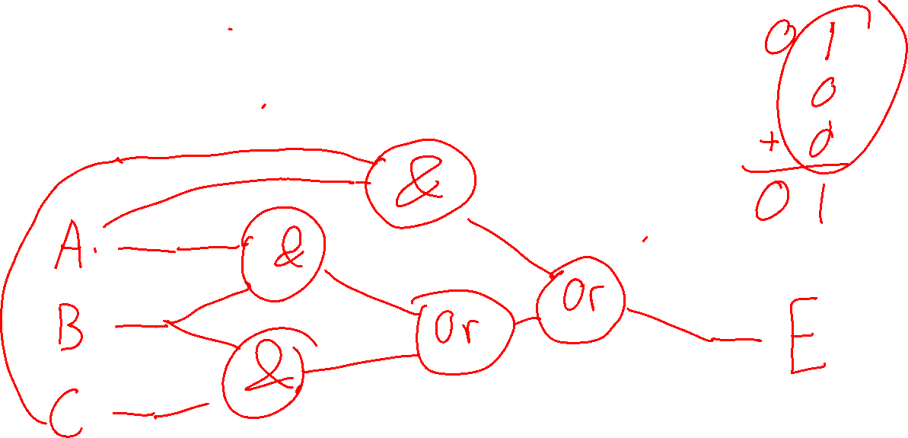
Gates for adding and carrying
$$E A$$
$$B$$
$$+ C$$
$D$
Express $D$ and $E$ in terms of $A,B,C$ using logic gates.

Slide 29
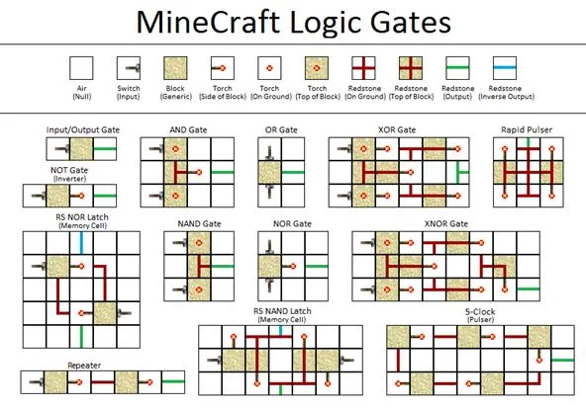

Slide 30
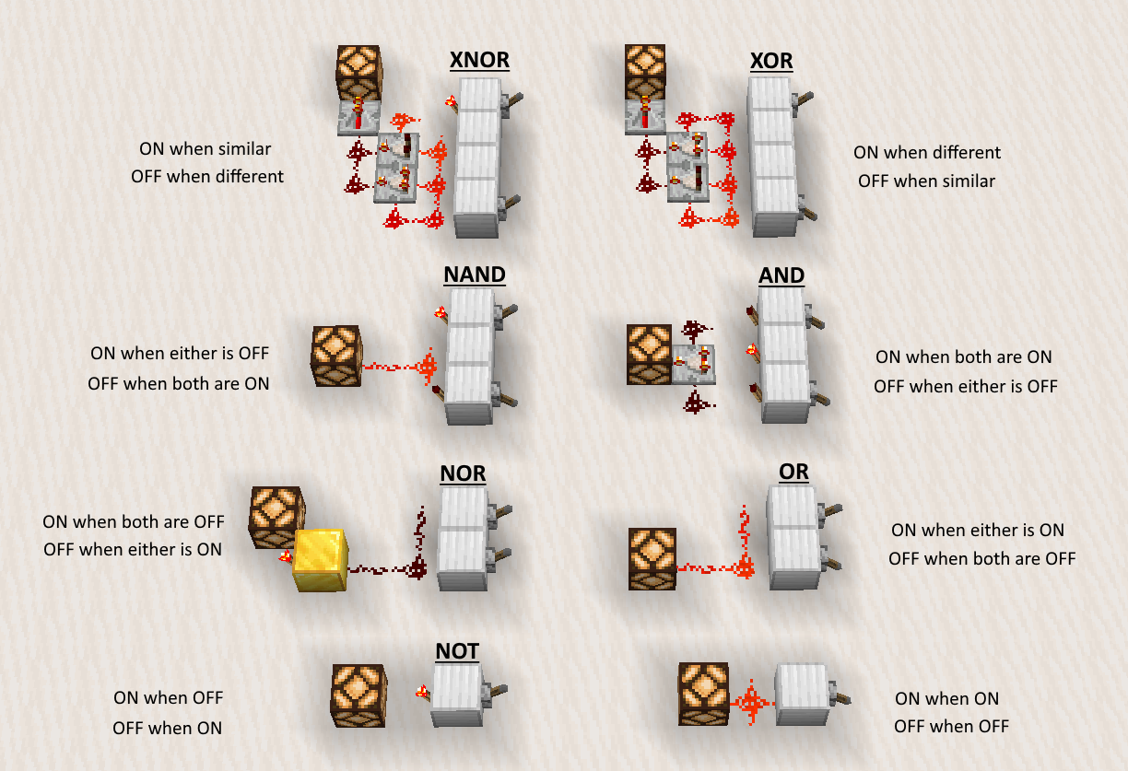
Alternative Minecraft logic gates

